Slide 1

German Academic Culture
Antonio Farfán-Vallespín
MEP Coordinator
MEP Orientation 2018

Slide 2
Some vocabulary
Prüfungsamt | Examination Office
Vorlesungsverzeichnis | Course Catalogue
Lehrstuhl | Chair (Professor‘s organizational unit)
Wirtschaftswissenschaften | Business + Economic Sciences
Volkswirtschaftslehre (VWL) | Economics
Betriebswirtschaftslehre (BWL) | Business Administration Studies
Fachschaft | German Student Union
KG - Kollegiengebäude | University Building
2
Notes:
2

Slide 3
1. Classroom etiquette
Efficient and polite participation is welcomed
Efficient:
  No „philosophical“ discussions with the Prof
  No questions you could answer if you would have prepared the lecture
  Efficient
Polite
  Not confrontational
  Raise your hand
Respect for your fellow students and the instructor

Slide 4
1. Classroom etiquette
Address people by their title:
  Herr Prof. Dr. XXY, Frau Prof. Dr.
  Dear Prof. Dr. XXX
  Dear Dr.
  Dear Mr. Or Ms.
Unless informal treatment is offered

Slide 5
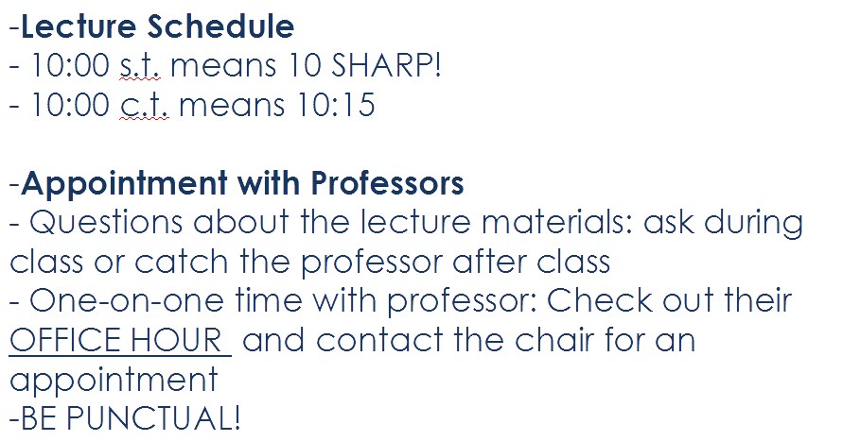
2. Time and schedules

Slide 6
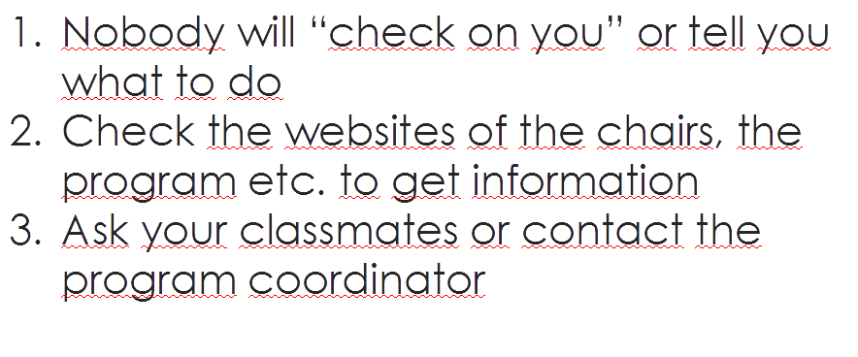
3. THE KEY: Being independent!

Slide 7
4. Exams: be precise, be efficient
Read the questions carefully
Answer exactly what has been asked
Those grading exams tend to have clear expectations on what you should answer
  Points awarded for specific items in the answer
  Keywords rather than long explanations
  Sometimes calculations give points, sometimes not
  Lecture or tutorial?
Time is of the matter
You have the right to an exam review

Slide 8
5. The Chair – Der Lehrstuhl
Each Professor: leader of a small, autonomous organizational unit
  Its own team:
    Secretary
    Assistants
      PhD candidates, teaching assistant and other tasks
    Student assistants (Hiwis) and tutors
  Its own budget
  Size varies greatly depending on research grants a.o.
Freedom to teach and research
Department decisions are made collectively

Slide 9
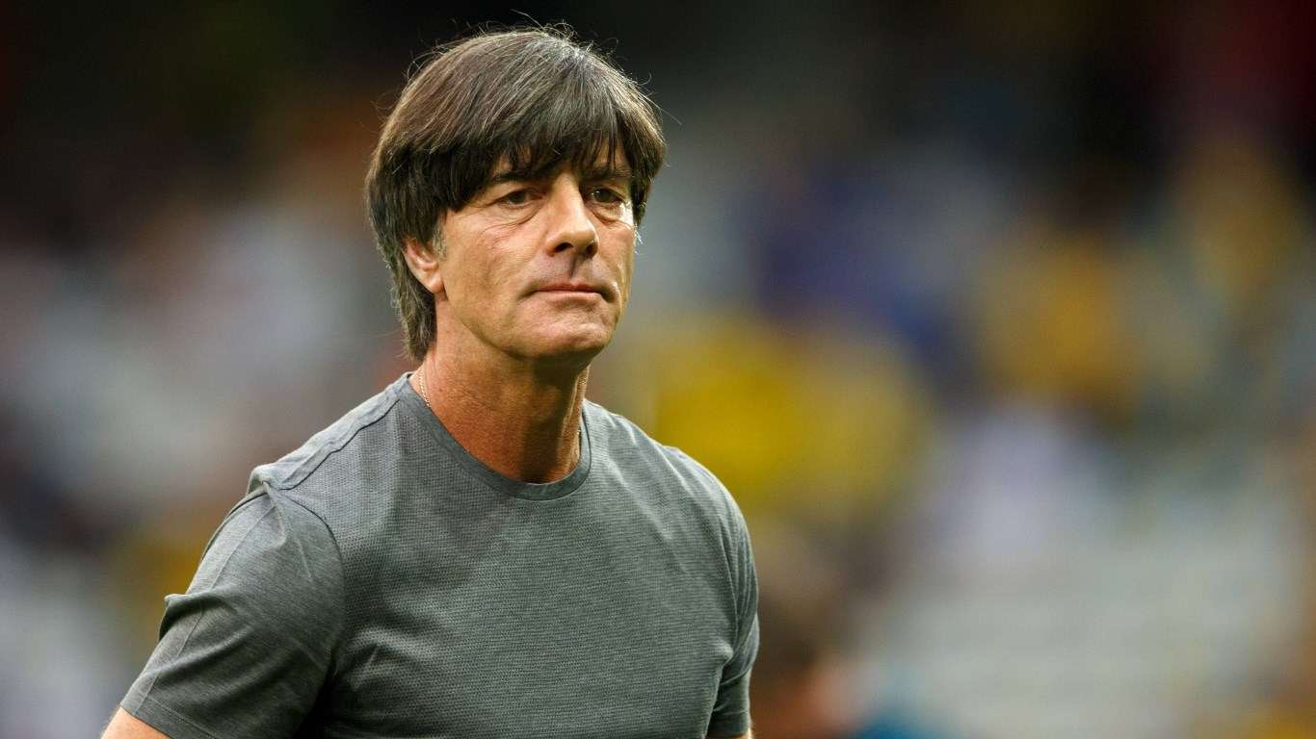
Questions?

