Slide 1
IT-Services at Uni-Freiburg
20 October 2018
Presented by Amanda Benecke

Slide 2
Important Brochures for getting settled at Uni-Freiburg
A Guide through Uni-Freiburg´s IT Services
  http://www.rz.uni-freiburg.de/inhalt/dokumente/pdfs/broschueren/studieng

Slide 3
WLAN
Eduroam
Eduroam keyword set up at myAccount

Slide 4
Main Online Platforms at Uni-Freiburg
myAccount
  Setting up passwords
  Printing
  Accessing computors at uni
Campus Management-HISinONE
  Regestering for exams
  Bills
  Transcripts and certificates
ILIAS
  E learning platform,
  Access to course material

Slide 5
Uni-Account
After matriculation activate your Uni-Account (page 5 of brochure University IT Services for Students)
  https://myaccount.uni-freiburg.de/uadmin/login
  Received initial password at matriculation
  Change initial password to personalized password
  Set up your eduroam keyword
  Put money on printing account

Slide 6
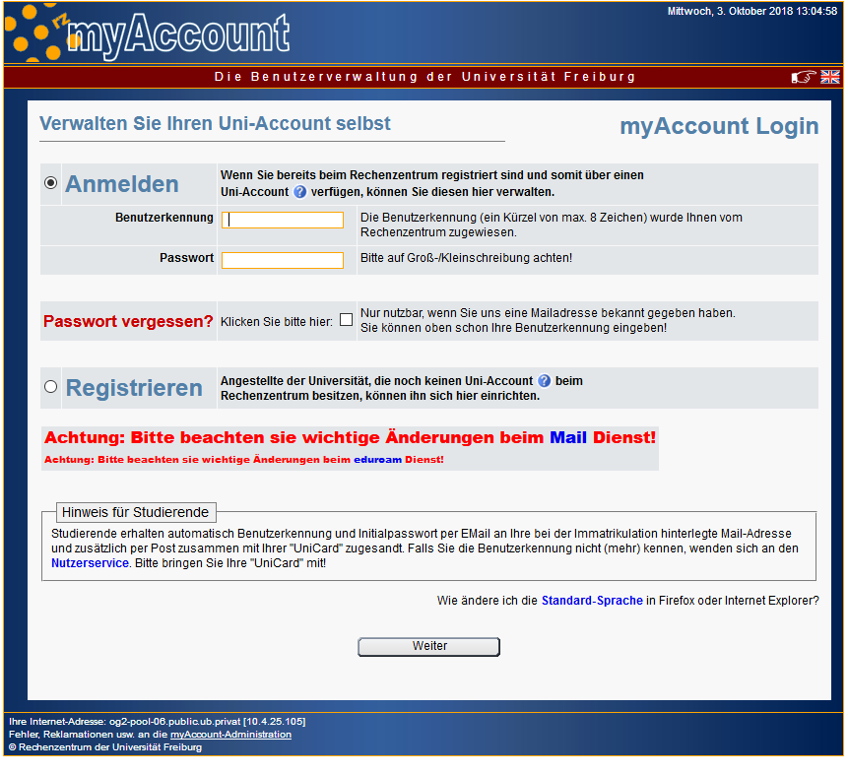

Slide 8
HISinONE
Campus Management
register for exams
create your own timetable
Access to matriculation certificate (Immatrikulationsbescheinigung)
  Needed for your semester ticket for example
Access to Proof of Records/Transcript (Leistungsübersicht)
Access to certificate of study

Slide 9
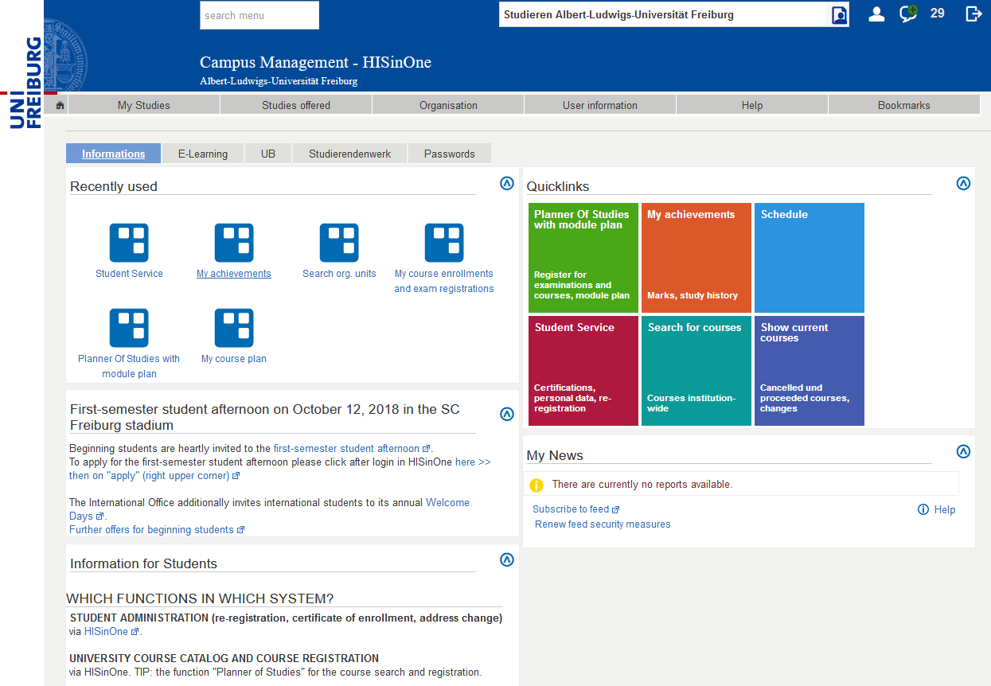

Slide 10
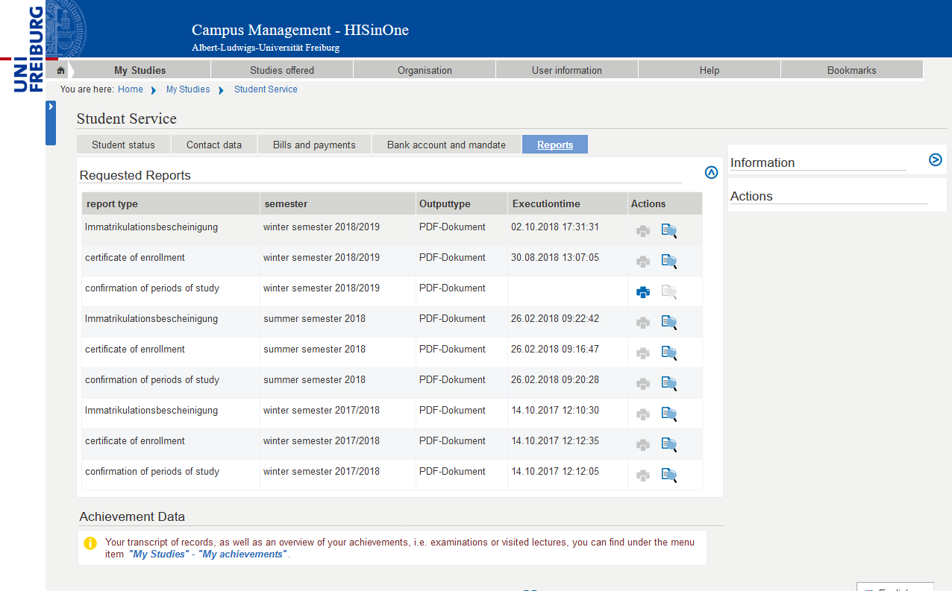

Slide 11
ILIAS- e learning at Uni-Freiburg
https://ilias.uni-freiburg.de/ilias.php?baseClass=ilrepositorygui&reloadpublic=1&cmd=frameset&ref_id=1

Slide 12
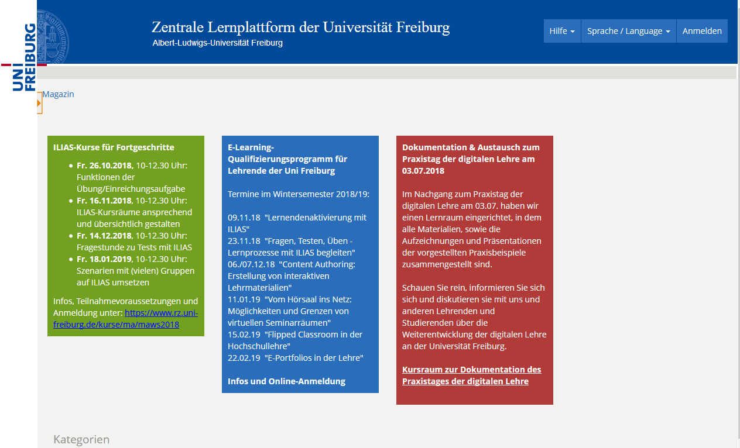

Slide 13
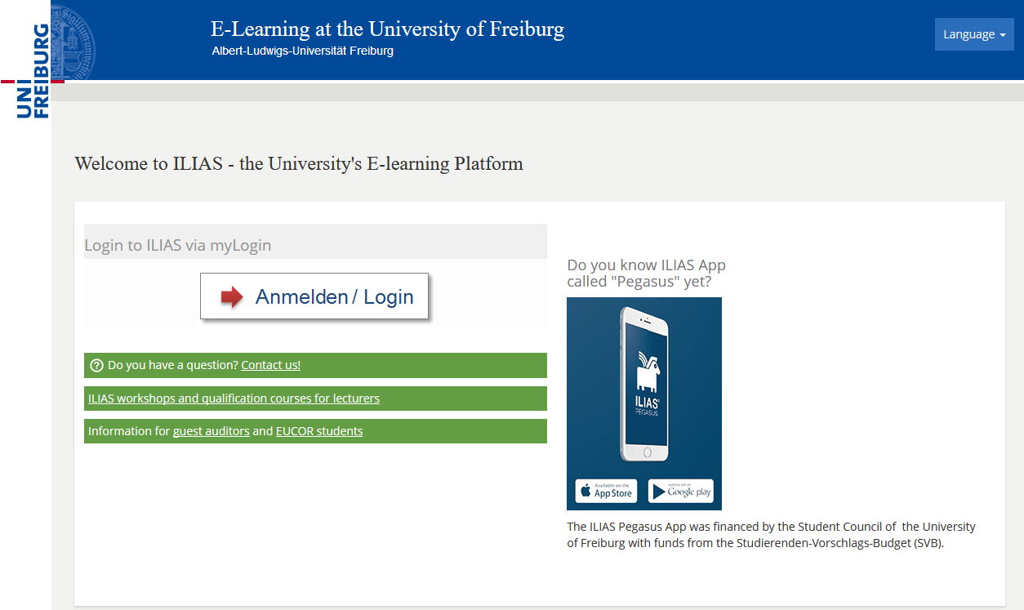

Slide 14
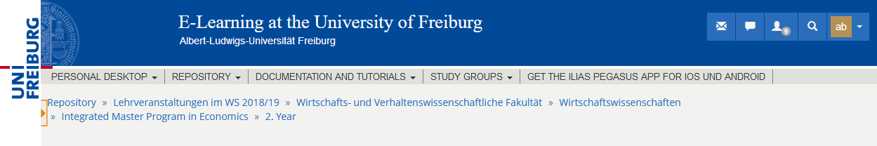

Slide 15
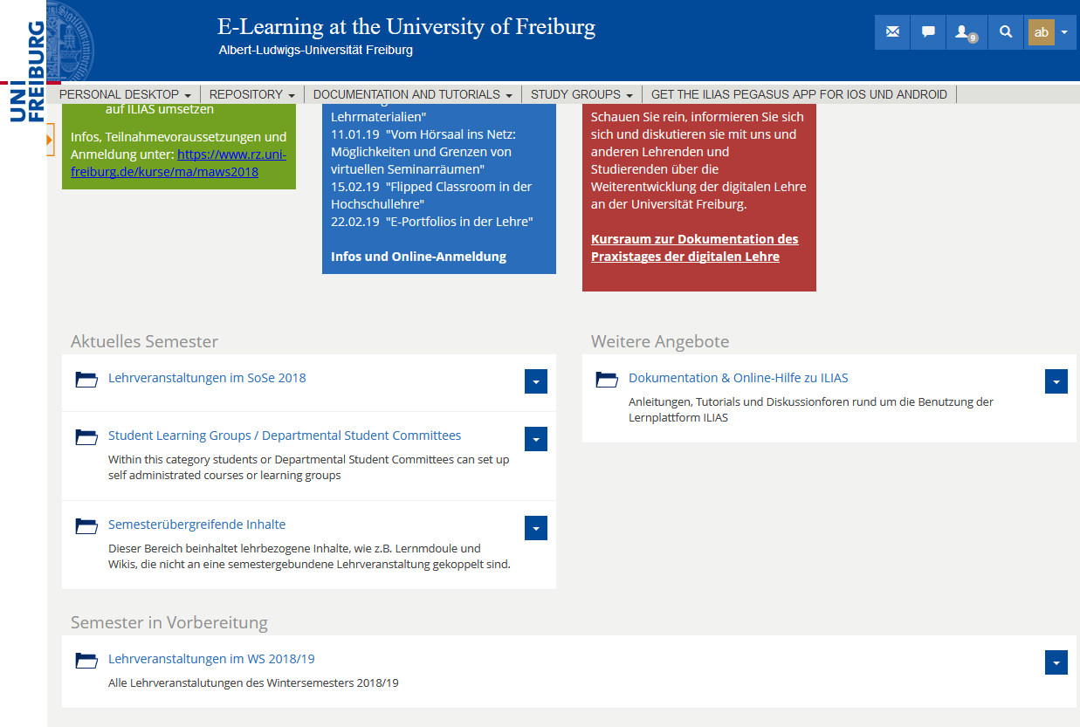

Slide 16
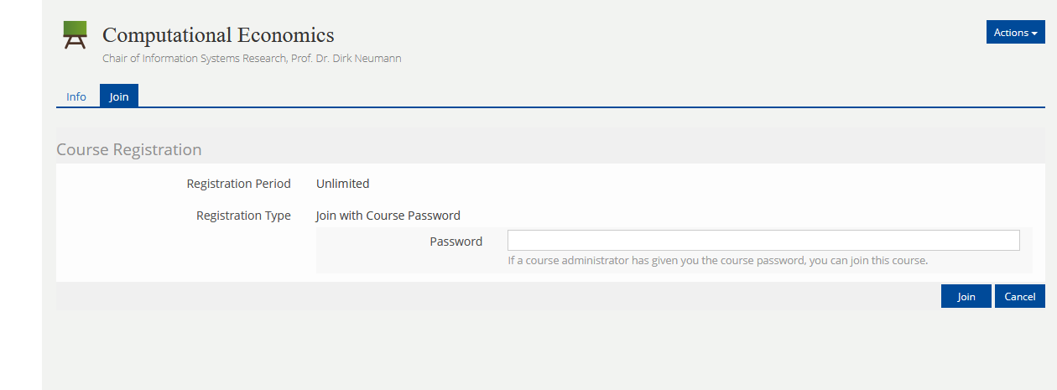

Slide 18

Dieses Folienlayout bitte nur verwenden, um großformatige Abbildungen wie in diesem Beispiel zu zeigen.
Es ist nicht für Texte etc. vorgesehen.

