Slide 1
Examination Rules
Version 07.12.2019
M.Sc. Economics
Intake 2019
December 5, 2019

Slide 2
Index
Required ECTS per block (replacements)
Grades & Transcripts
Repetition of Exams
What if you are ill on the day of the exam?
Strategies
Problems?
Changing the profile
Semester off
Going Abroad on exchange.
Special procedures
Registration next semester

Slide 3
1) Examination rules and where to find them

Slide 4
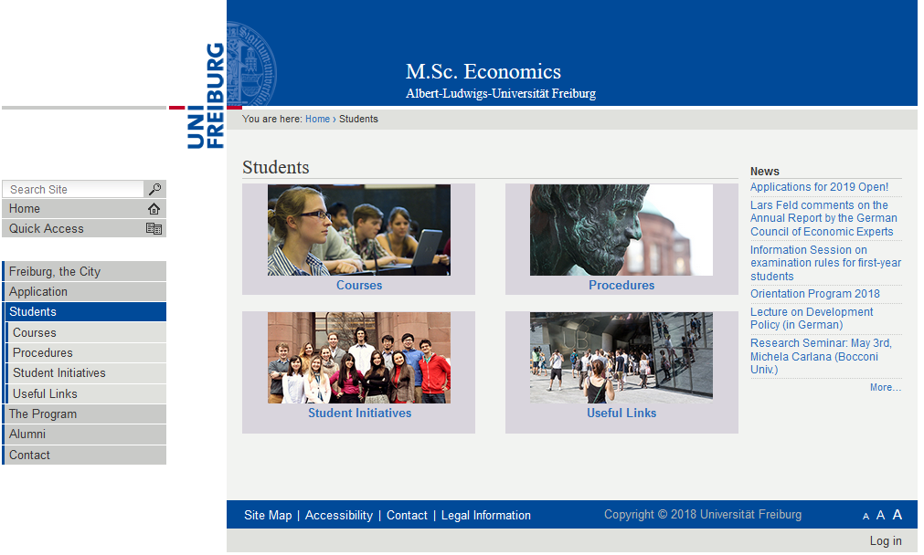

Slide 5
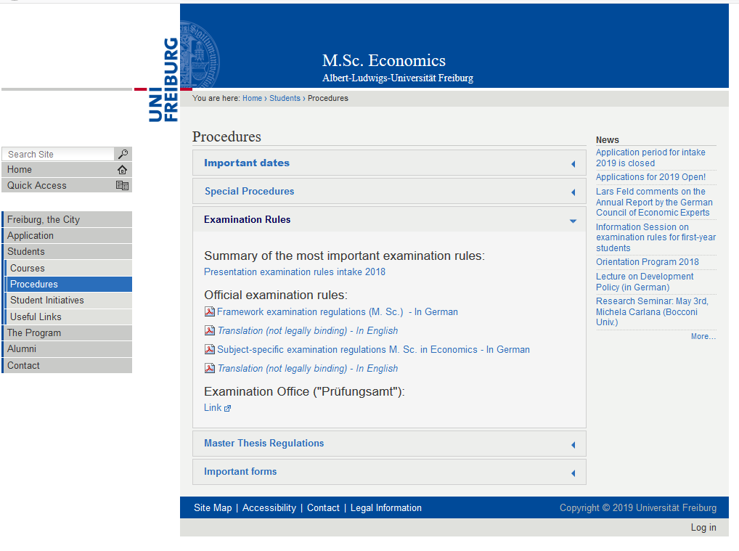

Slide 6
Required ECTS
120 ECTS
Economic Theory and Policy 30 ECTS
Quantitative Economics 16 ECTS
Specialization 6 ECTS
Elective Courses 44 ECTS
  Internal: Minimum 32 ECTS
  External: Maximum 12 ECTS
Master Thesis 24 ECTS

Slide 7
Economic Theory and Policy
Advanced Macro I (6 ECTS)
Advanced Micro I (6 ECTS)
Advanced Macro II (6 ECTS)
Advanced Micro II (6 ECTS)
EPPC (6 ECTS)
You must have at least 24 ECTS out of 30 ECTS
30 ECTS

Slide 8
Replacement Joker
You can replace one of the “Economic Theory and Policy” courses with another elective course of the 6 ECTS value.
When? From the moment you pass an elective course of 6 ECTS
Deadline? No
Advice: Do it when only one mandatory course is left.
Form for replacement can be found here:
https://master.econ.uni-freiburg.de/data/m-sc-economics-replacement-compulsory-course-form.pdf/view
You can send it to mep.admin@vwl.uni-freiburg.de

Slide 9
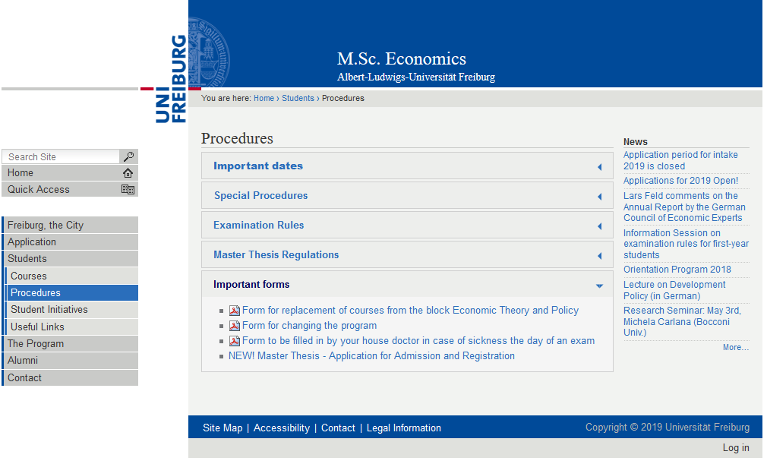
How to request a replacement?

Slide 10
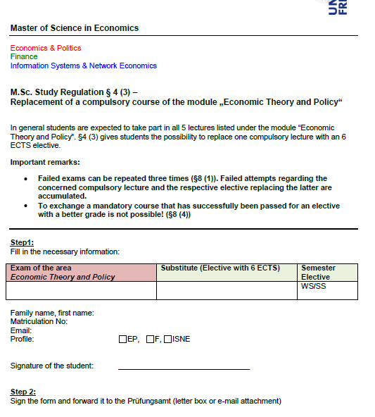
Request for replacement
Send the completed and scanned form to mep.admin@vwl.uni-freiburg.de

Slide 11
Quantitative Economics (16 ECTS)
Computational Economics (6 ECTS)
Intermediate Econometrics (10ECTS)
You can’t replace any of these courses

Slide 12
Specializations…
E&P: Constitutional Economics
F: Principles of Finance
You cannot take a specialization course from another profile.

Slide 13
Electives – 44 ECTS
Internal
At least (!!!) 32 ECTS from your area of specialization
External
Up to (!!!) 12 ECTS from another area of specialization
-
but still within Economics!
(no Art History sorry)

Slide 14
Master Thesis (24 ECTS)
You can start as soon as you get 70 ECTS (approved on 4.12.2019)
You have 20 weeks after registration to complete the thesis.
There is no obligation as to when you should register for your thesis.

Slide 15
Procedure of the master thesis
Find a supervisor (on your own)
  You can find some useful information on our website
Admission: Once supervisor agrees to supervise you, you can submit the admission form.
  No time constraint in this phase
Registration: Once you and your supervisor agree on the title, you can register the title of your thesis
  Then the 20 weeks start counting!

Slide 16
External supervisor?
You can have an external supervisor of your thesis….
But you need an „internal“ supervisor as well.
You must find a Professor from Freiburg who then should agree with the plan of the external supervisor.

Slide 17
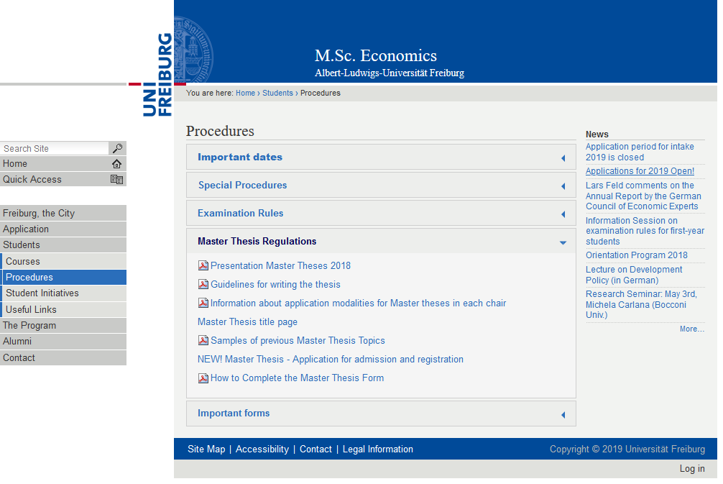

Slide 18
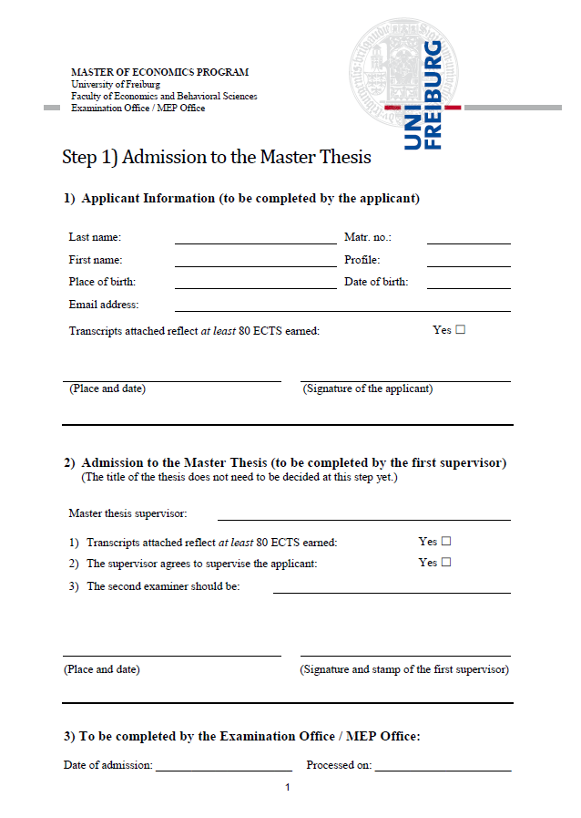
Step 1) Admission
Supervisor agrees to supervise you
Complete the upper part of the form and bring it to your supervisor
Your supervisor will complete the middle part and send it to the MEP Coordinator
MEP Coordinator will process the admission

Slide 19
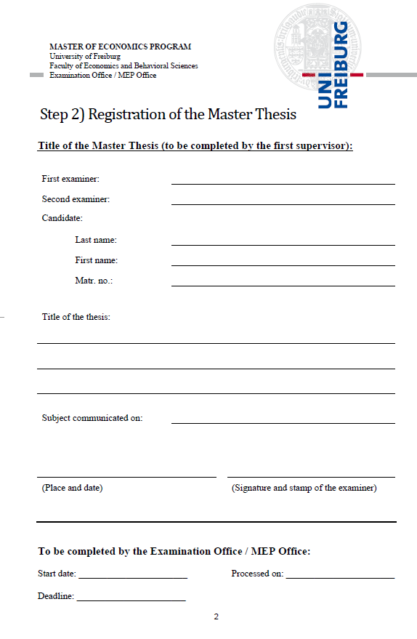
Step 2) Registration
Agree on the title of your thesis with your supervisor
Your supervisor completes the form and sends it to the MEP Coordinator
MEP Coordinator processes your title and sends you an e-mail informing you of the official title and the official deadline

Slide 20
Exam registration

Slide 21
Exams
Period for registration and deregistration: 20.12.2019 - 20.01.2020
No exceptions:
  no registration -> No exam

Slide 22
Exam schedule WS 19/20
February 17: EPPC
February 19: Advanced Math for Economics and Finance (*)
February 21: Advanced Micro. I
February 24: Computational Economics
February 26: Advanced Macro. I
* Recommended but not mandatory
Source: http://master.econ.uni-freiburg.de/students/procedures
http://portal.uni-freiburg.de/pa-vwl/Info-Veranstaltung%20M.Sc.%20WS%2015-16/Klausurplan%20WS%201920

Slide 23
First exams and retake exams
Every semester there are two types of exams :
  First exams (Hauptklausur):
    Exams of the courses being taught that same semester.
    Marked in the exam calendar with an „a“
  „Retakes“ (Wiederholungsklausur):
    Exams of the courses that were taught the previous semester.
    Marked in the exam calendar with „b“
You can register for both types of exam
  You can register or not register as you wish (until you pass the exam)
    You can choose not to register for some exams even if you took the course
    You can choose to register directly for the retake, even if you did not take the course, even if you did not write the first exam or even if you attended the lectures years ago.

Slide 24
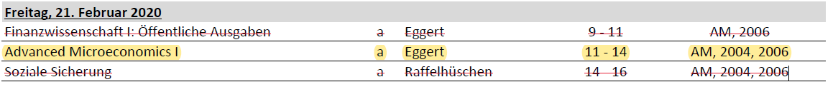
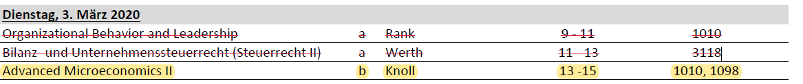
First exams and retake exams
Example first exam:
Example retake exam:

Slide 25

Grades

Slide 26
Average grade
The overall grade for the master examination is calculated from the weighted mean of the individual module grades and the grade of the thesis
Your 5.0 are not taken into account to your average grade.
You cannot retake exams to improve your grade

Slide 27
Transcripts
Failed courses appear in your trancripts with a 5,0 (fail)
Once you pass an exam, your previous failed attempts do not appear in the transcripts.
You can also get a transcript with just passed exams (no 5.0) from the Coordinator.

Slide 28
Improving your grades?
It is not possible to repeat exams once they are passed.
If you aim at having top grades and feel that an exam is not going well, you can always cross the exam.
  It will be failed, but you will have more chances to have top grade.
While you still have open electives, you can register for more exams than those you need, but you will have to pass all of them.
  The grade of all the exams will be included in your GPA.

Slide 29
When things get rough...

Slide 30


Slide 31
Repetition of Exams
Failed: You got 5.0 in the exam?!
  You can repeat the exam three times (1 + 3)
  => If you fail the 4th time you are exmatriculated
Failure in seminars:
Can repeat only once, usually after taking the seminar again

Slide 32
Important
You must acquire at least 30 ECTS after your first year
  First Exam WS + SS First Exam + Retake Exam of WS during SS
  They do not need to be in mandatory courses!!!
You have to pass at least one seminar to graduate
You can register directly for a retake

Slide 33

What if you are ill on the day of the exam?

Slide 34
What if you are ill on the day of the exam?
If you do not write an exam, you get a 5,0 (Fail)
You should see a doctor immediately
Take a medical form with you to be filled out by the doctor
Submit this medical certification within 3 days after the exam to Prüfungsamt (post box outside the door)
If approved, you will not get a 5,0, and it will not count for the 1+3 attempts rule.

Slide 35
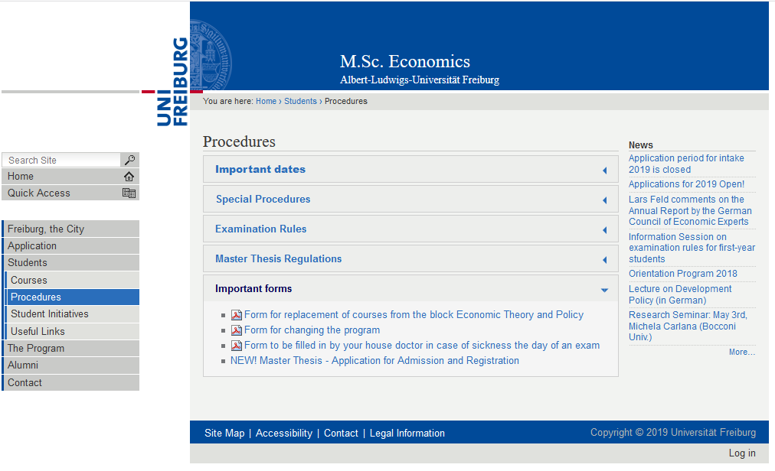

Slide 36
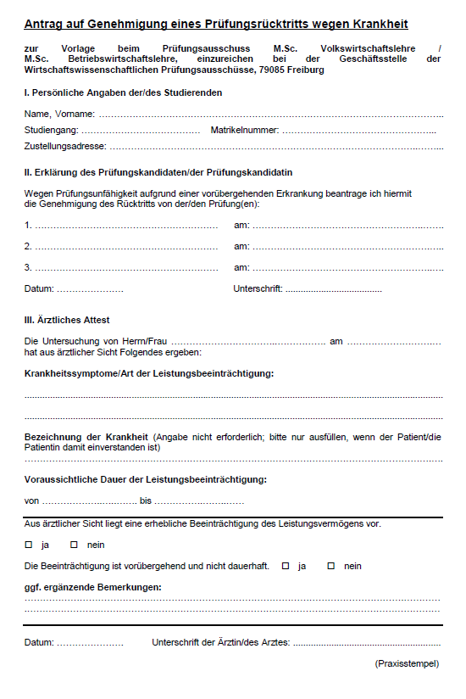
„Attest“
Important:
  The doctor should specify that on the day of the exam, you were not capable of writing an exam „Beeinträchtigung des Leistungsvermögens“
  Submit within 3 days of the exam day.

Slide 37
Strategies
What is your goal?
  Maximize your GPA?
    Take fewer exams, take some extra semesters.
    Cross exams in case of trouble.
  Survival?
    Do not take all mandatory courses the first year
    Take some easier exams or seminars
      (you must try really hard to fail a seminar)
    But still take some mandatory courses
Find your „optimal portfolio“ of hard/easy courses.

Slide 38
Tips & Tricks
If you are struggling now…
For the first year, just focus on the completion of 30 ECTS.
Consider taking less compulsory courses to ensure passing by decreasing workload.
If you do not feel comfortable with your background in economics or mathematics, try to take a seminar or several seminars.

Slide 39
What if you had bad grades?
Do not panic!
Try to postpone hysteria to a later date!
Do not stalk your professors!
BUT!
  Feel free to go to Prüfungsamt and to the MEP Coordinator to ask for advice and recommendations.
  They will assist you in creation your own studying plan and strategy.

Slide 40
What if you get into trouble during the semester and you cannot study?
You should write a letter to the Examination Board and give explicit explanations about your situation
Do it before the exams!!!
E.g. you were sick (medical certification needed), family reasons, psychological reasons etc.

Slide 41
You have a learning disability?
If you have a diagnosed learning disability..
You can apply at the Examination Office and obtain some special treatment to compensate for the disability.

Slide 42


Slide 43
Disaster?
You got exmatriculated because
  Failed an exam 4 times
  Did not achieve the 30 ECTS in the first year
What can you do?
  Ask yourself: Was this the right program for you?
  Was there an extraordinary reason for the lack of success?
    Health related? Family stress?
    You can still ask for a second chance if there was an extraordinary reason
    Cultural adaptation is not extraordinary

Slide 44

Want to try new things?

Slide 45
Changing the profile
Only possible after you have obtained your 30 ECTS the first year.
Send an email with your transcripts to the director of the desired profile explaining why you want to change.
Once the profile director agrees, go to the program coordinator for the official document.
You will then have to go to the IAO (International Admission Office) during the registration period (when you pay your fees for next semester).
Your change will be effective on the next semester.

Slide 46
Semester off
Valid reason: sickness, internship, exchange ...
Student status is kept and no tuition fees, except for registration fees (155 EUR)
You lose your right to take exams that semester
Fill in this form and submit it to IOS during registration period:
  http://www.studium.uni-freiburg.de/en/student-services/leave-of-absence/docs/uni-freiburg-application-for-a-leave-of-absence.pdf
Maximum 2 semesters
More info:
  http://www.studium.uni-freiburg.de/en/student-services/leave-of-absence?set_language=en

Slide 47

Going Abroad?

Slide 48
International Program Office of the Department of Economics
https://portal.uni-freiburg.de/vwl-international
Coordinator ERASMUS & Internships abroad: Dr. Steffen Minter
Consultation hour:
During the semester: Wednesday 3 - 4pm, room 2311
Non-lecture period: only by agreement
E-Mail: steffen.minter@vwl.uni-freiburg.de
Information Session ERASMUS:
12.12 14:15 room HS1199 (in German)

Slide 49
Check EUCOR!
http://www.studium.uni-freiburg.de/en/counseling/exchange-programs-and-studying-abroad/eucor?set_language=en
https://portal.uni-freiburg.de/pa-vwl/eucor
You can attend courses in Basel, Karlsruhe, Strasbourg, and Mulhouse-Colmar
They offer many courses in English!!!
(Relatively) easy acknowledgement
You can get reimbursements!!!
Pay attention to the different starting time and registration requirements!!!

Slide 50
Acknowledgement of courses from other Universities
Before taking the course abroad:
Ask the Erasmus Coordinator before you start the course abroad
After taking the course:
Go to the Examination Office (Ms. Grünholz)
  They will check formalities
  You will get the official form there
Go with the form to the Erasmus coordination office

Slide 51
Acknowledgement of courses from other Universities
The course will be acknowledged if:
  Master level
  Economics (sometimes Business or Informatics as well...)
  Partner University or sufficiently „good“
Coordinator decides:
  Acknowledged or not
  Which course from Freiburg it replaces or
  Internal or external elective if it is not offered in Freiburg

Slide 52
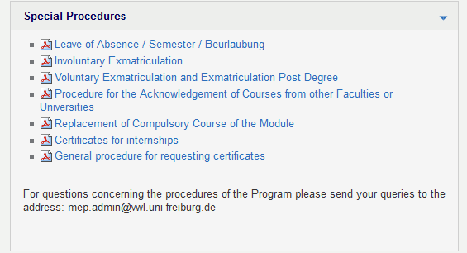
Special procedures:

Slide 53
Registration next semester
Registration Deadlines:
  SS 2020: January 15th to February 15th, 2020
  WS 2020/21: June 1st to August 15th, 2020
http://www.studium.uni-freiburg.de/en/student-services/registration

Slide 54


