Slide 1
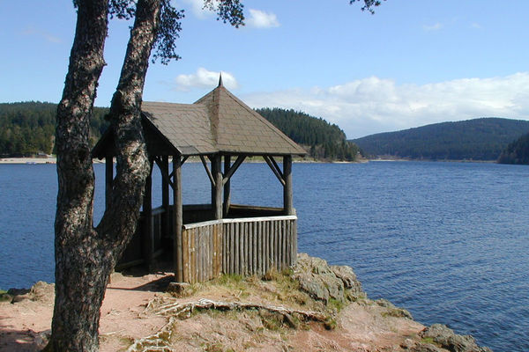
Orientation Schluchsee
Intake 2018

Slide 2
  MEP Program Office & Prüfungsamt
 | Antonio Farfán-Vallespín Program Coordinator M.Sc. in Economics Room: KG II 2301 Consultation Hours: Tuesdays from 10:30 to 11:30 a.m. Wednesdays from 11:30 to 12:30 a.m

Slide 3
My tasks
Information
  Examination rules and courses
  How to find the right „window“ in the bureaucracy
Part of the examination office
  Submission of Master theses, forms, …
Maintaining course catalogue
Official documents
  Transcripts, certificates, …
Counseling
Link between students and Faculty
Making sure you are ok

Slide 4
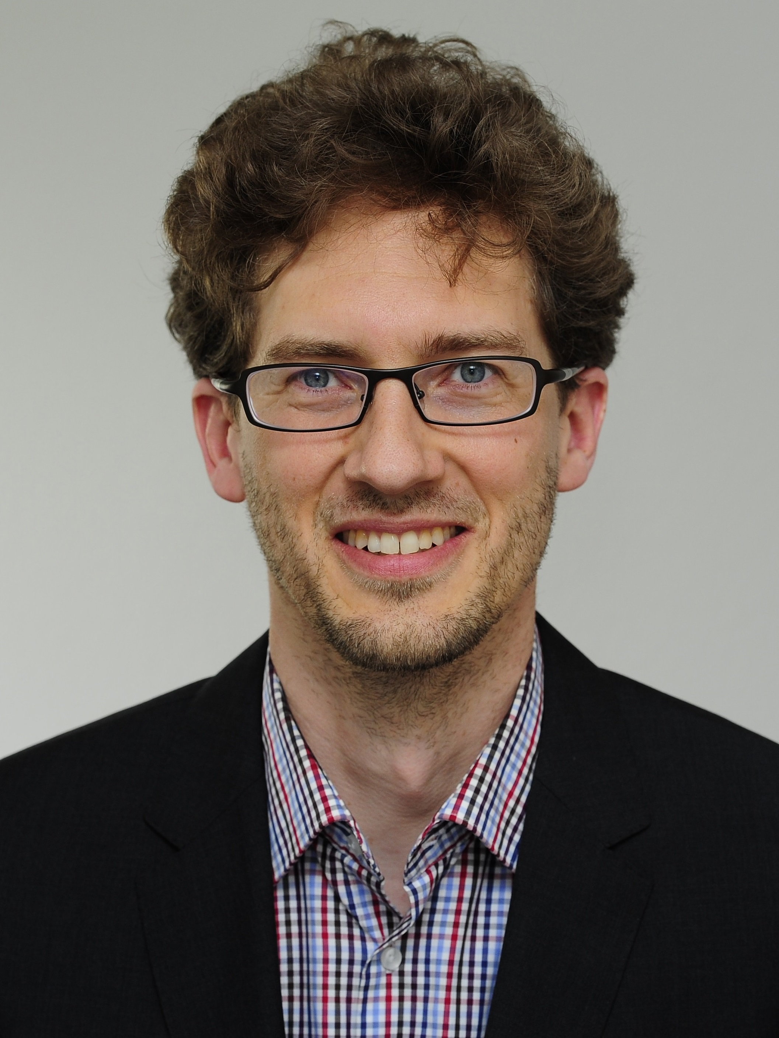
MEP Professors / Academic Coordinators
(Acting) Program Director: Prof. Dr. Tim Krieger

Slide 5
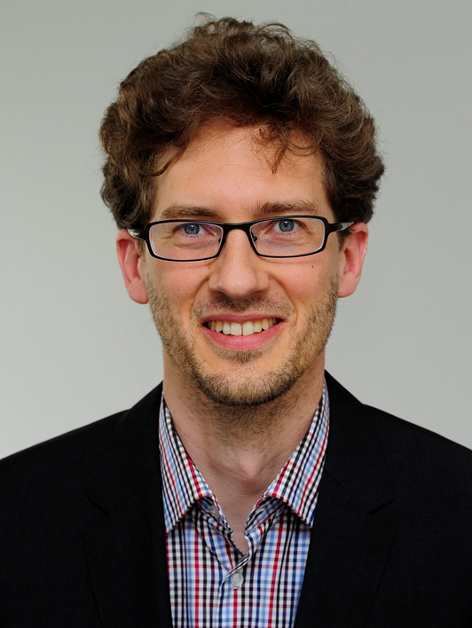
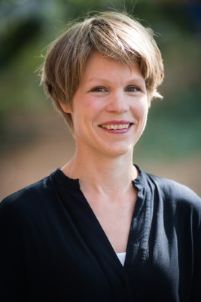
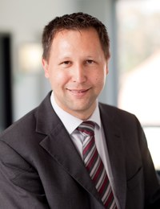
MEP Professors / Academic Coordinators
EP | F | ISNE
Prof. Dr. Krieger | Prof. Dr. Lütkebohmert-Holtz | Prof. Dr. Neumann

Slide 6
Where to find information about...
  Courses?
  Regulations?
  Exams?
  Activities?
  ...

Slide 7
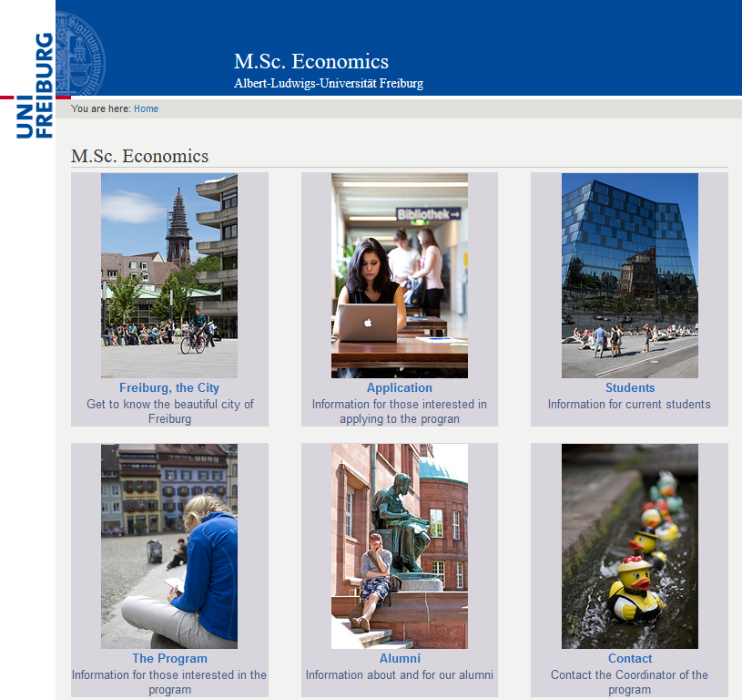

Slide 8
Courses

Slide 9
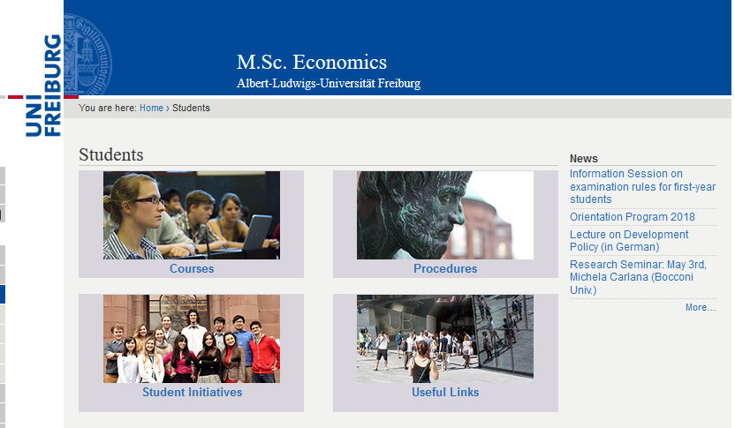

Slide 10
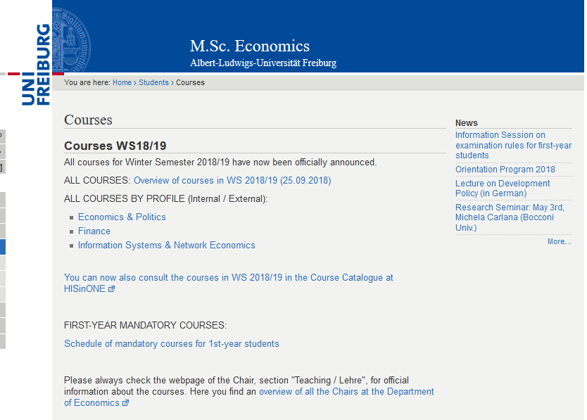

Slide 11
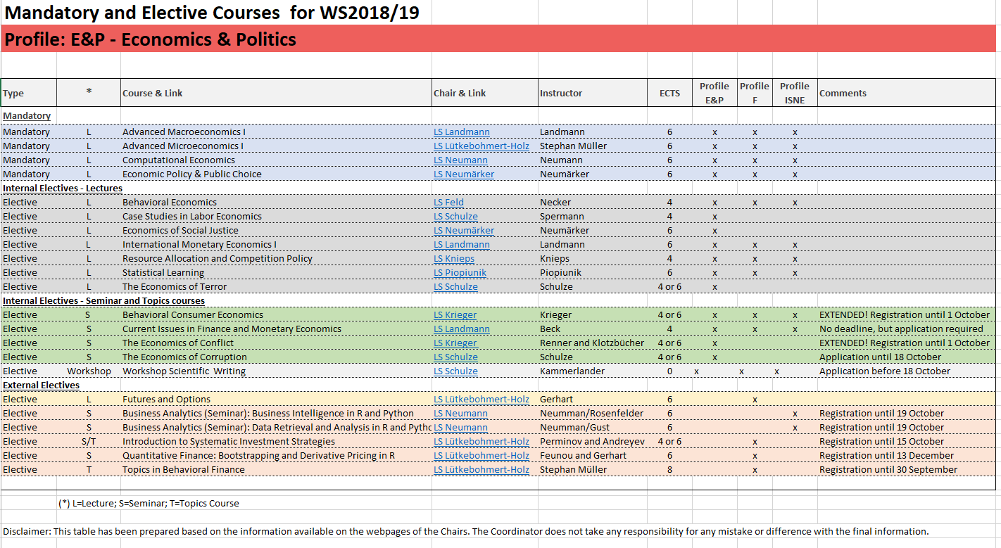

Slide 12
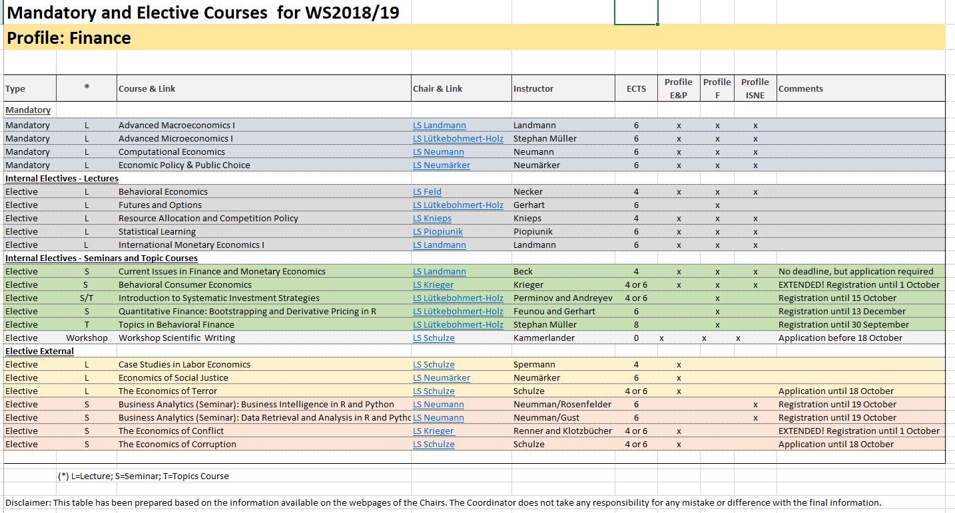

Slide 13
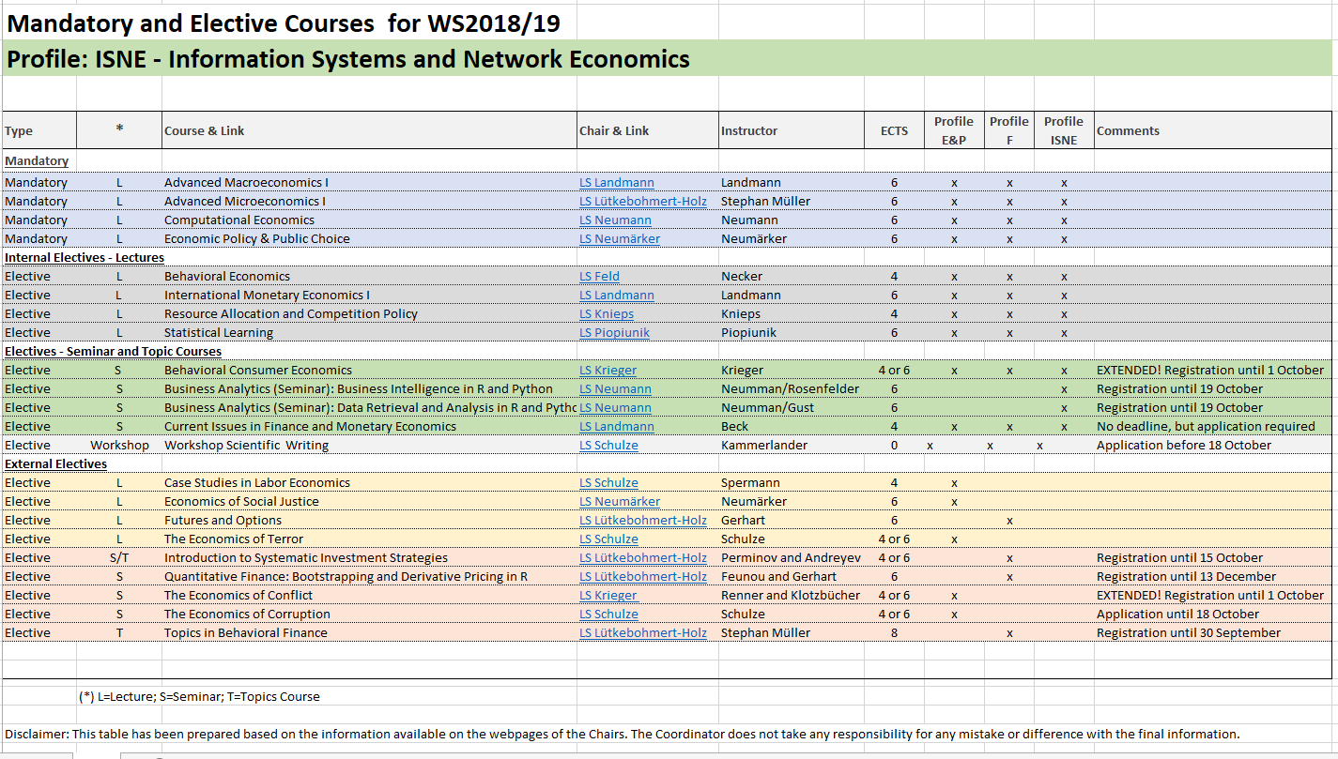

Slide 14
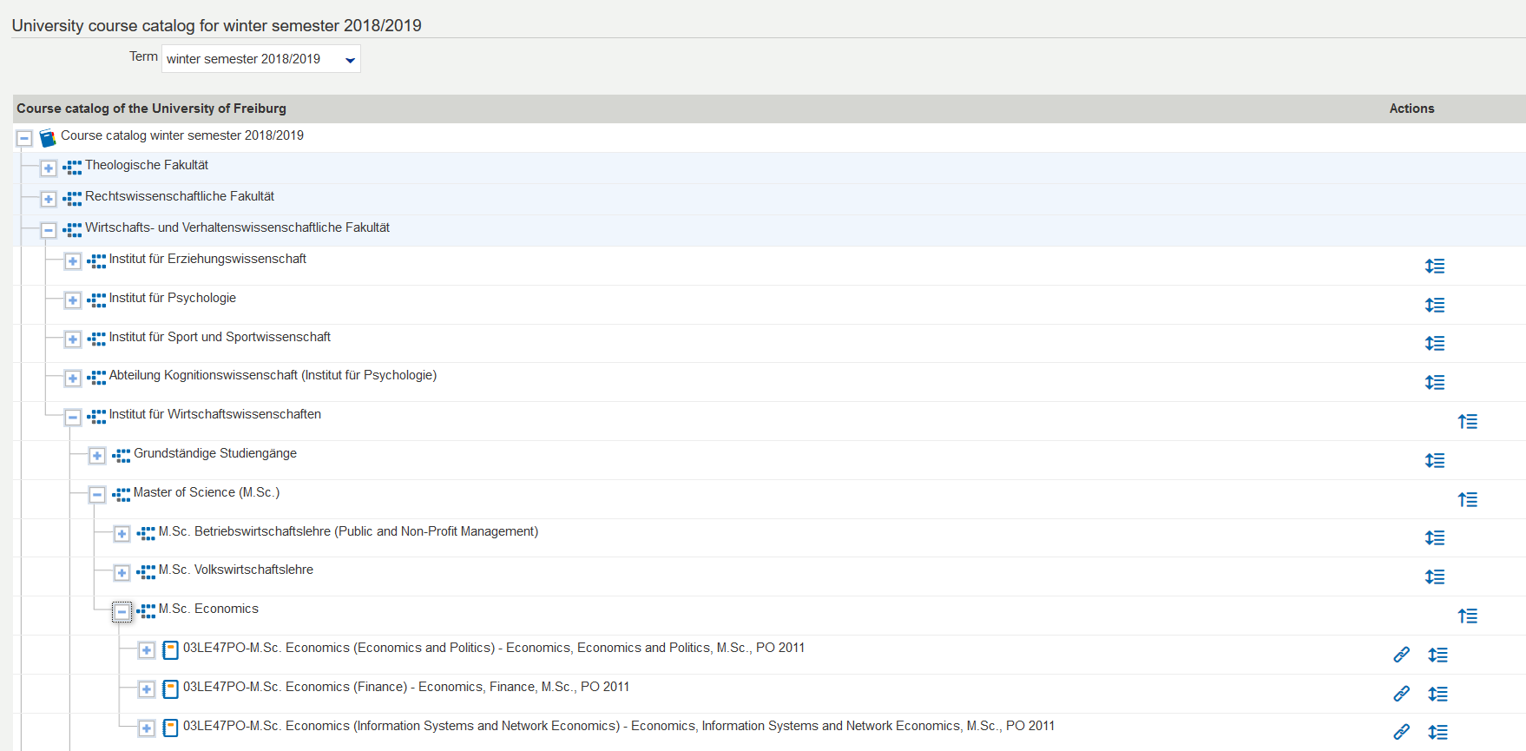

Slide 15
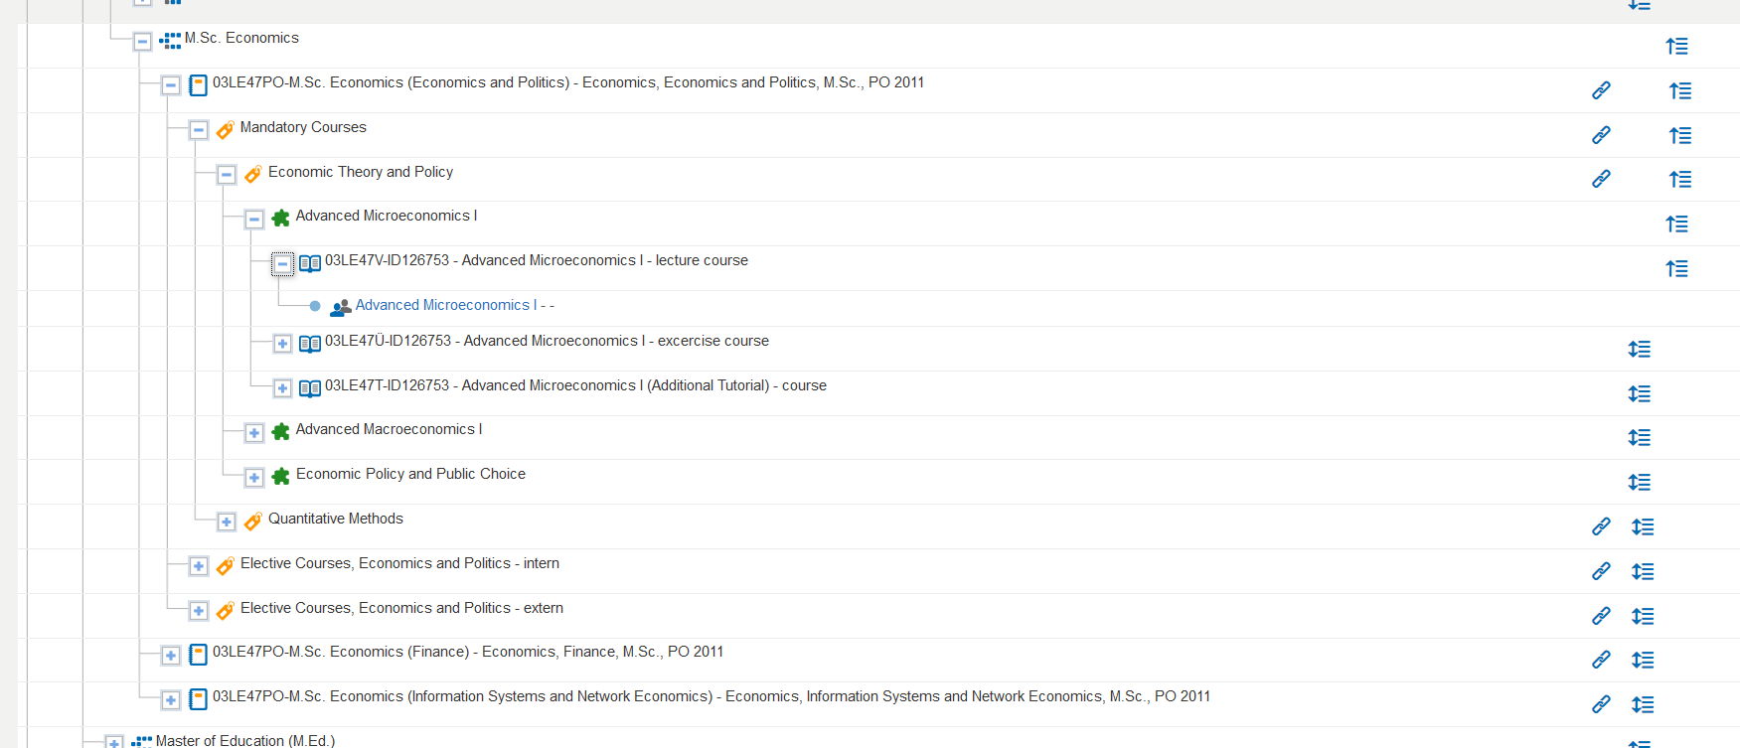

Slide 16
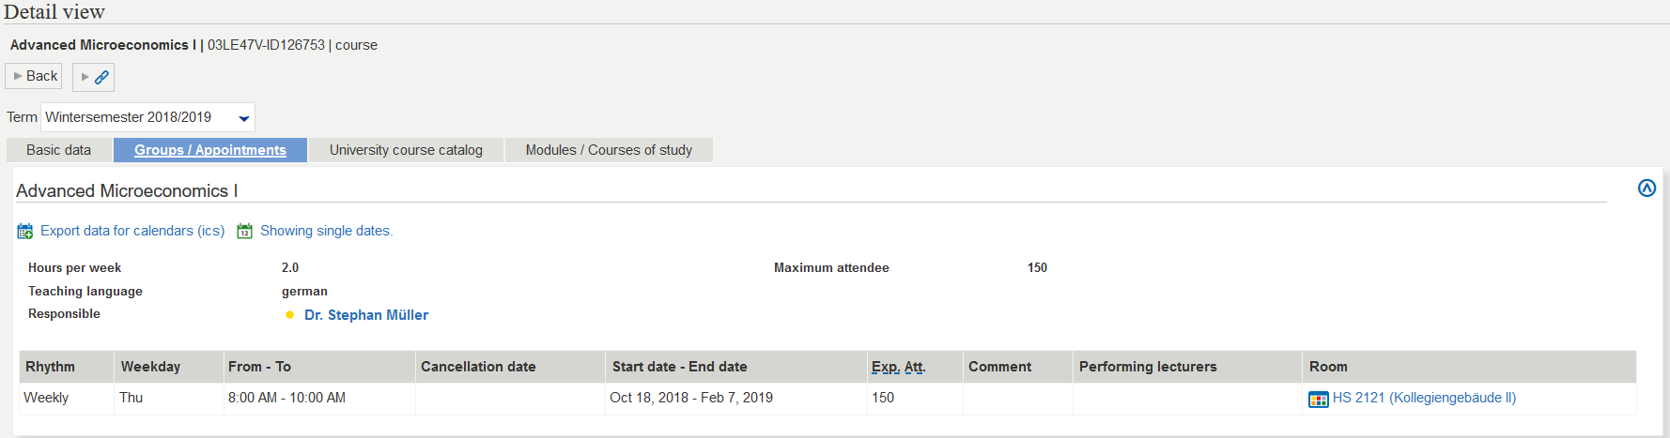

Slide 17
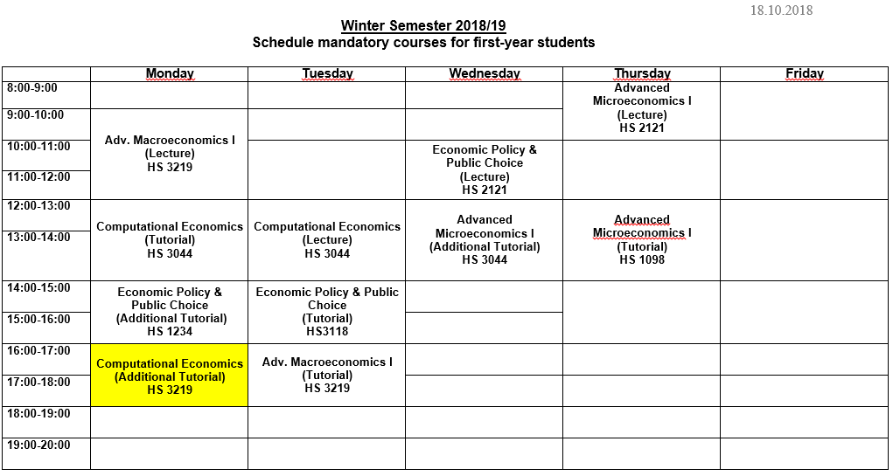

Slide 18
Which courses should I take?

Slide 19

Structure of the program
1st year: Compulsory courses:
Advanced Macro I (1)
Advanced Macro II (2)
Advanced Micro I (1)
Advanced Micro II (2)
Economic Policy and Public Choice (1)
Intermediate Econometrics (2)
Computational Economics (1)
2nd semester:
Constitutional Economics (EP)
Principles of Finance (F)
Network Economics / Electronic Markets (ISNE)

Slide 20
Two-years track
First semester: Only mandatory
  Very time-consuming
  Foundation of the elective courses
Second semester:
  Mandatory + 2 or 3 electives
    Depending on 1st semester performance
Third semester:
  Electives
Fourth semester:
  Few electives + Thesis

Slide 21
Three-years track
First semester: Only mandatory
  Very time-consuming
  Foundation of the elective courses
Second semester:
  Mandatory + 1 or 2 electives
    Depending on 1st semester
Third and fourth semester:
  Electives
Fifth: Internship or exchange
Sixth: Thesis

Slide 22
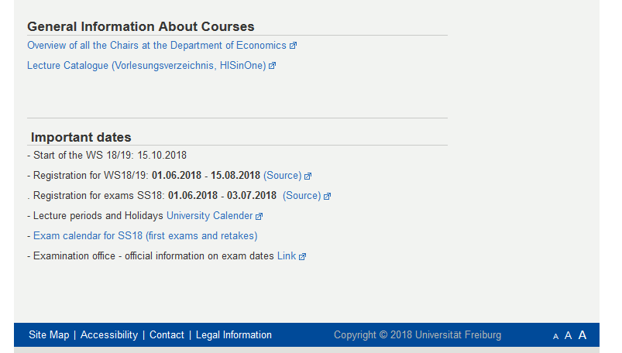

Slide 23
Procedures

Slide 24
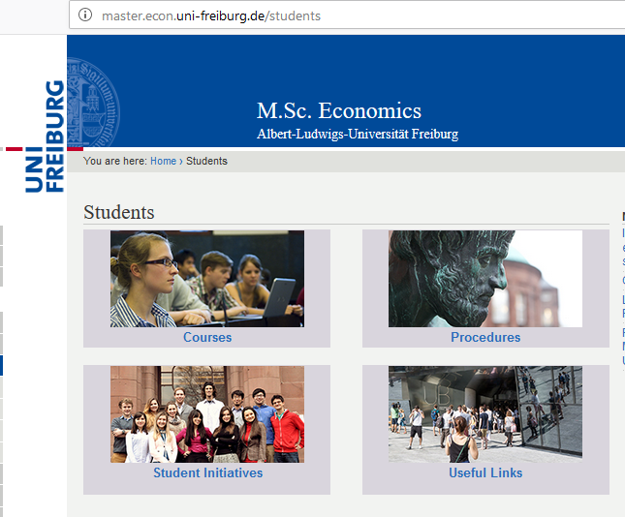

Slide 25
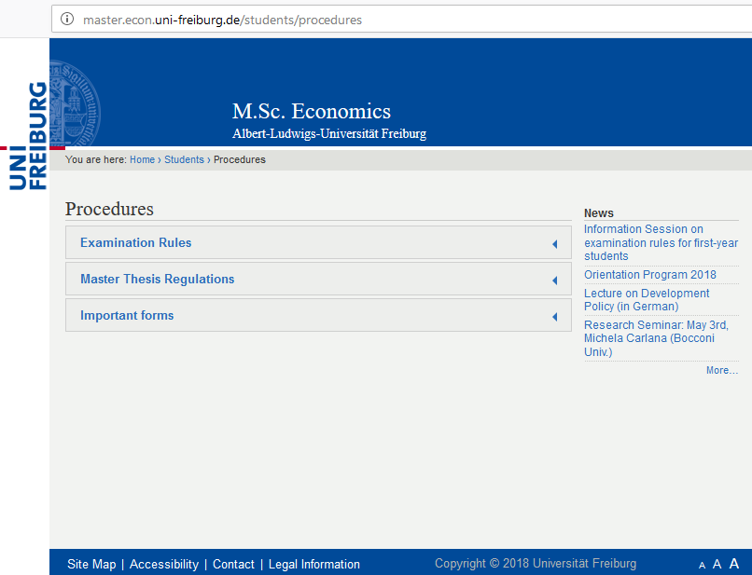

Slide 26
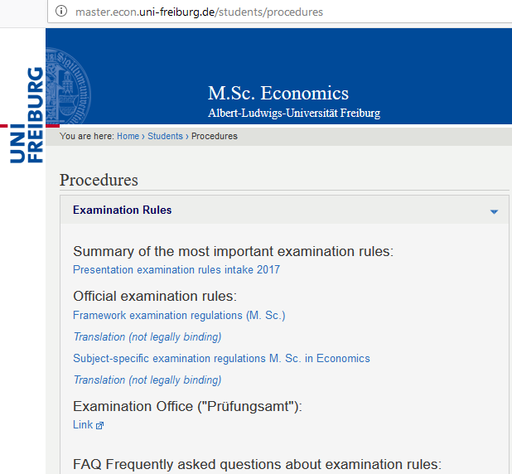

Slide 27
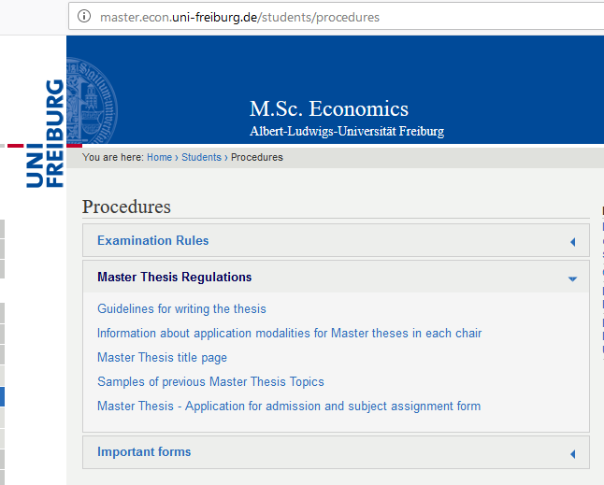

Slide 28
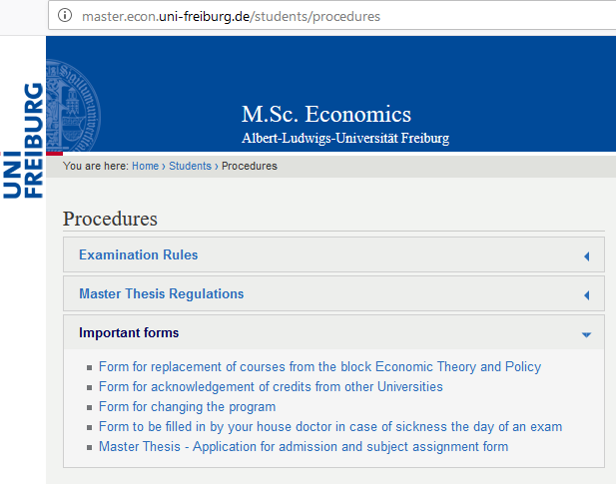

Slide 29
Examination rules

Slide 30
M.Sc. Economics
120 ECTS
Economic Theory and Policy 30 ECTS
Quantitative Economics 16 ECTS
Specialization 6 ECTS
Elective Courses 44 ECTS
  Internal: Minimum 32 ECTS
  External: Maximum 12 ECTS
Master Thesis 24 ECTS

Slide 32
Economic Theory and Policy
Advanced Macro I (6 ECTS)
Advanced Micro I (6 ECTS)
Advanced Macro II (6 ECTS)
Advanced Micro II (6 ECTS)
EPPC (6 ECTS)
You must have at least 24 ECTS out of 30 ECTS
30 ECTS

Slide 33
Replacement
(a.k.a. The Joker)
You can replace
one of the Economic Theory and Policy courses
with another internal elective course
of 6 ECTS value.
Form for replacement can be found here:
https://master.econ.uni-freiburg.de/students/replacement-compulsory-course-form

Slide 34
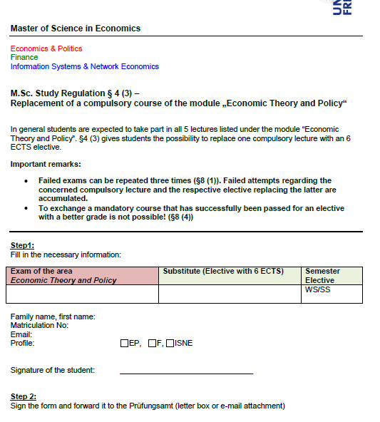
How to replace a mandatory course by an elective?

Slide 35
Quantitative Economics (16 ECTS)
Computational Economics (6 ECTS)
Intermediate Econometrics (10ECTS)
You can’t replace any of the courses

Slide 36
Specializations…
E&P: Constitutional Economics
F: Principle of Finance
ISNE : Network Economics or Electronic Markets
Starting SS18 you cannot take a specialization course from another profile and have it as an internal course (from your area of specialization), only as external!
Exception: Electronic Markets

Slide 37
Electives – 44 ECTS
Internal
At least (!!!) 32 ECTS from your area of specialization
External
Up to (!!!) 12 ECTS from another area of specialization
-
but still within Economics!
(no Art History sorry)

Slide 38
Master Thesis (24 ECTS)
You can start as soon as you get 80 ECTS
(there is a proposal to reduce it to 70 but it is still not approved)
You have 20 weeks after registration to complete it.
There is no obligation as to when you should register for your thesis

Slide 39
Procedure of the master thesis
Find a supervisor (on your own)
Once he agrees to supervise you, register your thesis
  No time constraint in this phase
Once you and your supervisor agree on the titel, you can register the title of your thesis
  Then the 20 weeks start counting!

Slide 40
Repetition of Exams
Failed: You got 5.0 in the exam?!
  You can repeat the exam three times (1 + 3)
  => If you fail the 4th time you are exmatriculated
Exams in seminars:
Can repeat only once, usually after taking the seminar again

Slide 41
Important
You must acquire at least 30 ECTS after your first year
  First Exam WS + SS First Exam + Retake Exam of WS during SS
  They do not need to be in mandatory courses.
You have to pass at least one seminar to graduate
You can register directly for a retake

Slide 42
What if you are ill the day of the exam?
If you do not write an exam you get a 5,0 (Fail)
You should see a doctor immediately
Take a medical form*with you to be filled out by the doctor
Submit this medical certification within 3 days after the exam to Prüfungsamt (post box outside the door)
If approved, you will not get a 5,0, and it will not count for the 1+3 attempts rule.
http://portal.uni-freiburg.de/pa-vwl/Info-Veranstaltung%20M.Sc.%20WS%2015-16/formulare/m.sc.-vwl/krankmeldung

Slide 43


Slide 44

Erasmus and
academic exchanges

Slide 45
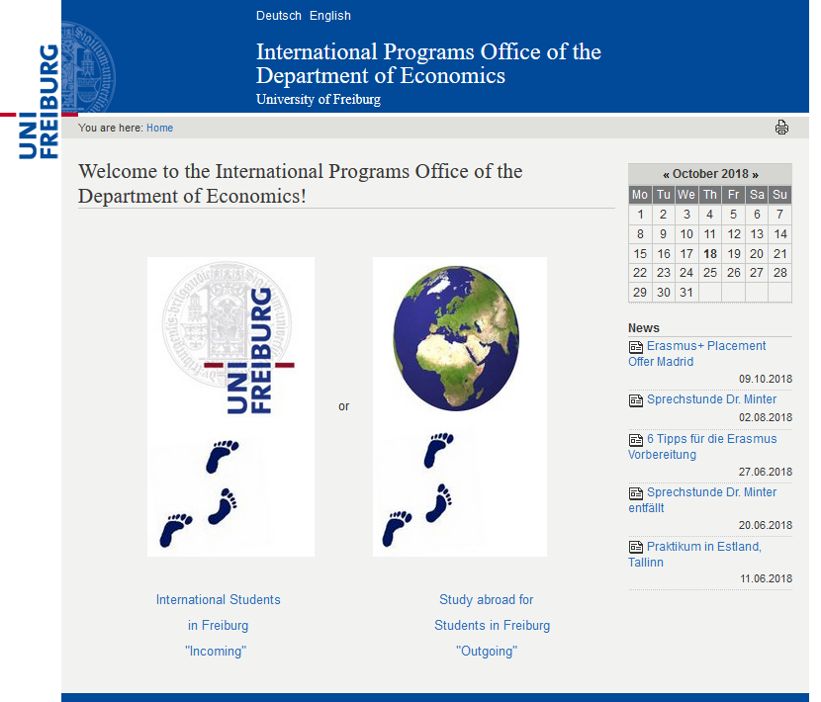

Slide 46
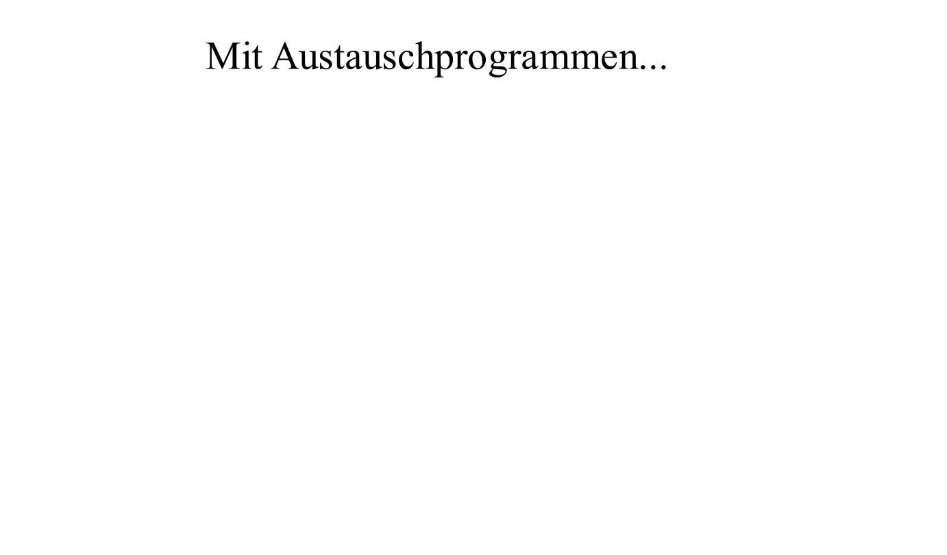
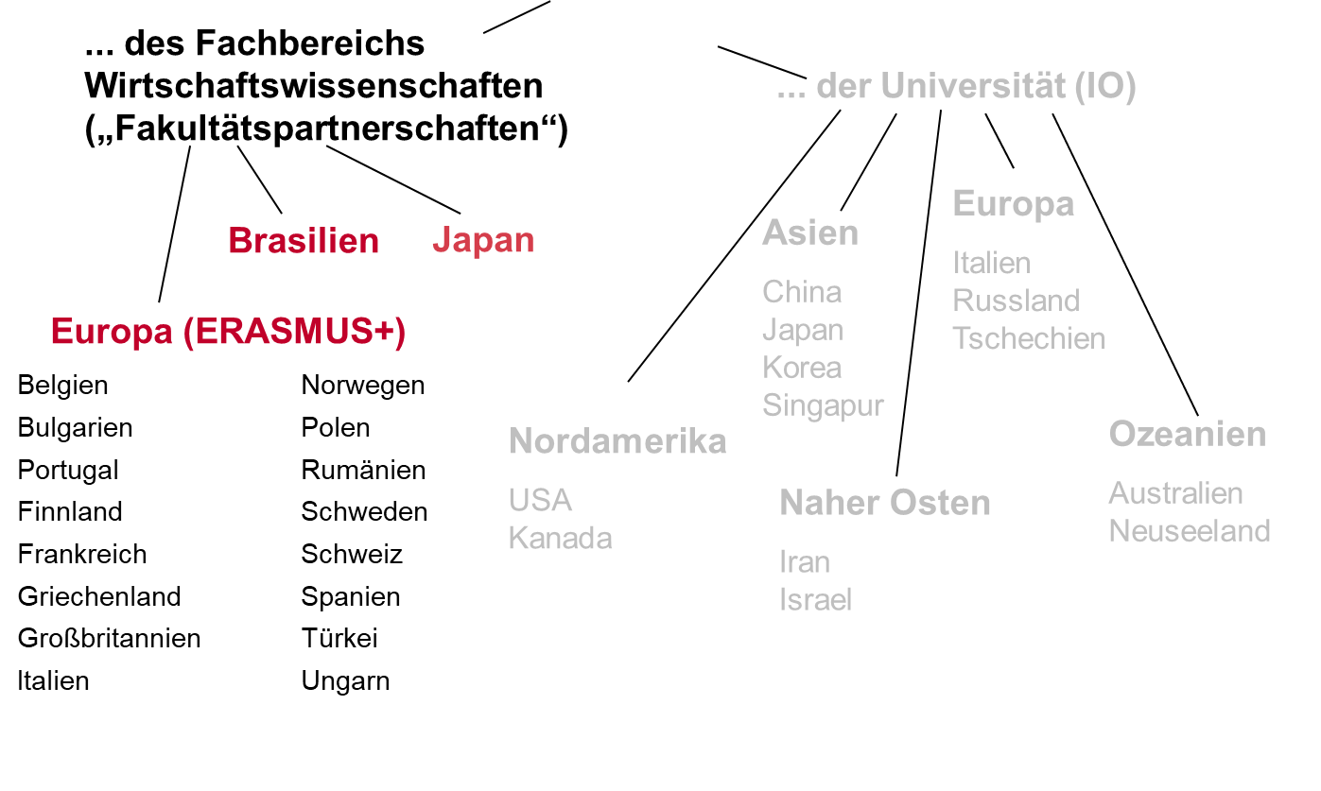
Where?

Slide 47
Agreement with partner University at the Department level
Short stages also possible, minimum three months
Advising and supervision by the responsibles of the exchange program
Acknowledgement of courses
No fees at the destination University
Minimum language level B1 or higher
Very positive experience from students
Support of 255€ / 315€ / 375 € per month depending on the country

Slide 48
Application
Send applications per E-Mail to the
International Programs Office of the Department of Economics –
Period of application (for 2018): January 1st - January 19th
Application form
Tabular CV
Current transcripts
Motivation letter (in German)
→in one pdf file to erasmus@vwl.uni-freiburg.de

Slide 49
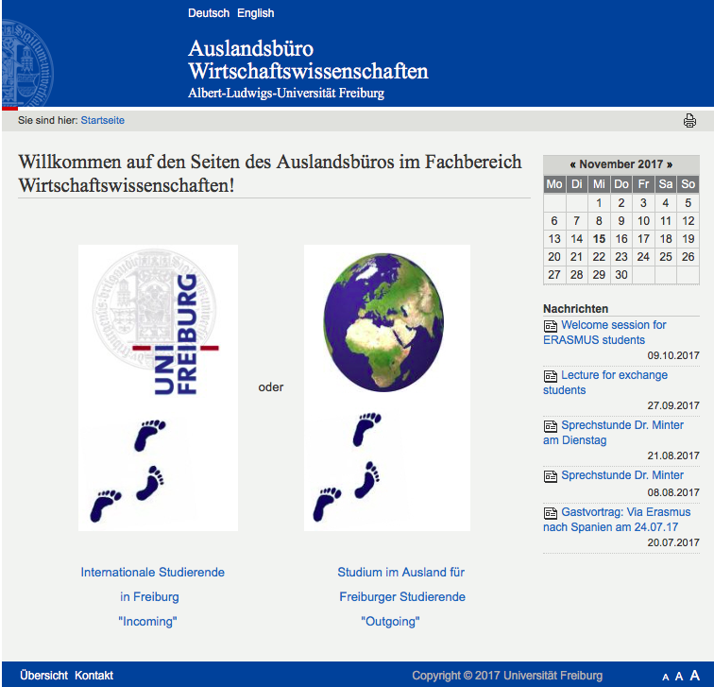
Informationsbeschaffung
Dr. Steffen Minter
Raum 2311
Sprechzeiten:
Mi 15-16 Uhr
Alexandra Kromer
Studentische Hilfskraft
in Erasmus-Angelegenheiten
Sprechzeiten:
Nach Vereinbarung
https://portal.uni-freiburg.de/vwl-international/
49
Notes:
49

Slide 50
Scholarships

Slide 51
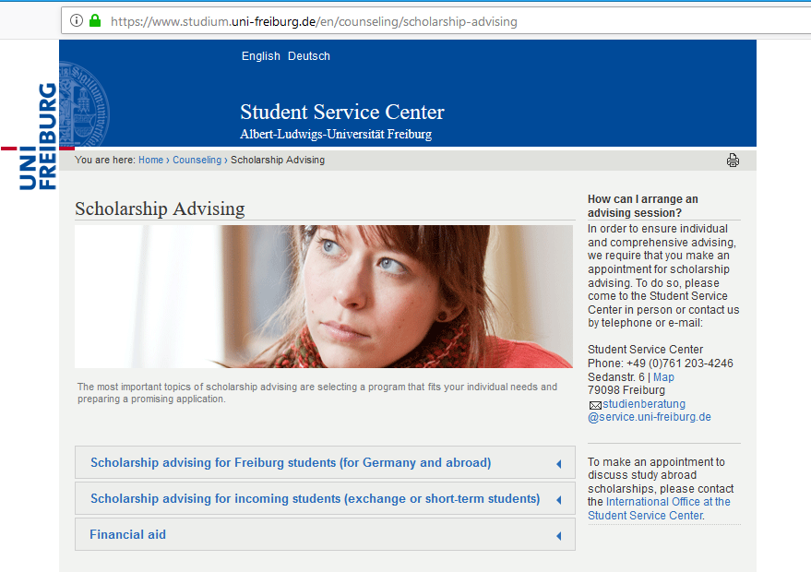

Slide 52
Political foundations
CDU: Konrad-Adenauer-Stiftung
SPD: Friedrich-Ebert-Stiftung
Green Party: Heinrich-Böll-Stiftung
FDP: Friedrich-Naumann-Stiftung für die Freiheit
Die Linke: Rosa-Luxemburg-Stiftung

Slide 53

Thank you very much for your attention!
Enjoy your stay ☺

