Slide 1
Examination Rules
M.Sc. Economics
Intake 2017
Updated on March 27 2018

Slide 2
M.Sc. Economics
120 ECTS
Economic Theory and Policy 30 ECTS
Quantitative Economics 16 ECTS
Specialization 6 ECTS
Elective Courses 44 ECTS
  Internal: Minimum 32 ECTS
  External: Maximum 12 ECTS
Master Thesis 24 ECTS

Slide 3
Economic Theory and Policy
Advanced Macro I (6 ECTS)
Advanced Micro I (6 ECTS)
Advanced Macro II (6 ECTS)
Advanced Micro II (6 ECTS)
EPPC (6 ECTS)
You must have at least 24 ECTS out of 30 ECTS
30 ECTS

Slide 4
Replacement Joker
You can replace one of the “Economic Theory and Policy” courses with another elective course of the 6 ECTS value.
Form for replacement can be found here:
https://master.econ.uni-freiburg.de/students/replacement-compulsory-course-form
You can send it to mep@vwl.uni-freiburg.de

Slide 5
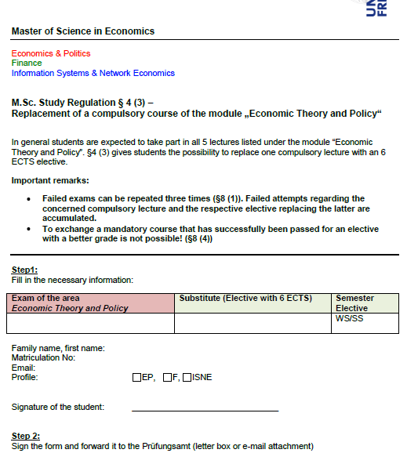
Request for replacement

Slide 6
Quantitative Economics (16 ECTS)
Computational Economics (6 ECTS)
Intermediate Econometrics (10ECTS)
You can’t replace any of the courses

Slide 7
Specializations…
E&P: Constitutional Economics
F: Principle of Finance
ISNE : Network Economics or Electronic Markets
Starting SS18 you cannot take a specialization course from another profile
Update March 2018: Network Economics or Electronic Markets are open to students from the three profiles.

Slide 8
Electives – 44 ECTS
Internal
At least (!!!) 32 ECTS from your area of specialization
External
Up to (!!!) 12 ECTS from another area of specialization
-
but still within Economics!
(no Art History sorry)

Slide 9
Master Thesis (24 ECTS)
You can start as soon as you get 80 ECTS
(there is a proposal to reduce it to 70 but it is still not approved)
You have 20 weeks after registration to complete the thesis.
There is no obligation as to when you should register for your thesis.

Slide 10
Procedure of the master thesis
Find a supervisor (on your own)
Once he agrees to supervise you, register your thesis
  No time constraint in this phase
Once you and your supervisor agree on the titel, you can register the title of your thesis
  Then the 20 weeks start counting!

Slide 11
When things get rough...

Slide 12


Slide 13
Repetition of Exams
Failed: You got 5.0 in the exam?!
  You can repeat the exam three times (1 + 3)
  => If you fail the 4th time you are exmatriculated
Failure in seminars:
Can repeat only once, usually after taking the seminar again

Slide 14
Important
You must acquire at least 30 ECTS after your first year
  First Exam WS + SS First Exam + Retake Exam of WS during SS
  They do not need to be in mandatory courses!!!
You have to pass at least one seminar to graduate
You can register directly for a retake

Slide 15
What if you are ill the day of the exam?
If you do not write an exam you get a 5,0 (Fail)
You should see a doctor immediately
Take a medical form*with you to be filled out by the doctor
Submit this medical certification within 3 days after the exam to Prüfungsamt (post box outside the door)
If approved, you will not get a 5,0, and it will not count for the 1+3 attempts rule.

Slide 16
What if you had bad grades?
Do not panic!
Try to postpone hysteria to a later date!
Do not stalk your professors!
BUT!
  Feel free to go to Prüfungsamt and to the MEP Coordinator
  to ask for advice and recommendations.
  They will assist you in creation your own studying plan and strategy.

Slide 17
What if you get into trouble during the semester and you cannot study?
You should write a letter to the Examination Board and give explicit explanations about your situation
Do it before the exams!!!
E.g. you were sick (medical certification needed), family resons, psychological reasons etc.

Slide 18
You have a learning disability?
If you have a diagnosed learning disability..
You can apply at the Examination Office and obtain some special treatment to compensate for the disability.

Slide 19


Slide 20
Disaster?
You got exmatriculated because
  Failed an exam 4 times
  Did not achieve the 30 ECTS the first year
What can you do?
  Ask yourself: Was this the right program for you?
  Was there an extraordinary reason for the lack of success?
    Health related? Family stress?
    You can still ask for a second chance if there was an extraordinary reason
    Cultural adaptation is not extraordinary

Slide 21

Wanna try new things?

Slide 22
Changing the profile
Only possible after you have obtained your 30 ECTS the first year.
Send an email with your transcripts to the director of the desired profile explaining why you want to change.
Once the profile director agrees, go to the program coordinator for the official document.
You will then have to go to the IAO during the registration period (when you pay your fees for next semester).
Your change will be effective on the next semester.

Slide 23
Semester off
Valid reason: sickness, internship, exchange ...
Student status is kept and no tuition fees, except for registration fees (155 EUR)
You lose your right to take exams that semester
Fill in this form and submit it to IOS during registration period:
http://www.studium.uni-freiburg.de/documents/container/studierendensekretariat/beurlaubung.pdf
Max 2 periods
More infos http://www.studium.uni-freiburg.de/studium/formalia/beurlaubung/beurlaubung?set_language=de

Slide 24

Going Abroad?

Slide 25
International Program Office of the Department of Economics
https://portal.uni-freiburg.de/vwl-international/kontakt-en
Coordinator ERASMUS & Internships abroad: Dr. Steffen Minter
Consultation hour:
During the semester: Wednesday 3 - 4pm at Schreiberstraße 20, 4th floor
Non-lecture period: only by agreement
E-Mail: steffen.minter@vwl.uni-freiburg.de
Coordinator for Non-European Faculty Partnerships:
Mrs. Gabriele Rothardt
E-Mail: international@vwl.uni-freiburg.de
Consultation hours: Mo-Fr 9:30 - 11:30 am

Slide 26
Check EUCOR!
http://www.studium.uni-freiburg.de/studienbewerbung/austausch/eucor
You can attend courses in Basel, Karlsruhe, Strassbourg, and Mulhouse-Colmar
They offer many courses in English!!!
(Relatively) easy acknowledgement
You can get reimbursements!!!
Pay attention to the different starting time and registration requirements!!!

Slide 27
Acknowledgement of courses from other Universities
Fill in special form from our website
Present it to your profile director
He will decide on whether it can be acknowledged or not
Master courses from Economics from recognized Universities should have no problems being acknowledged

Slide 28

Grades

Slide 29
Average grade
The overall grade for the master examination is calculated from the weighted mean of the individual module grades and the grade of the thesis
Your 5.0 are not taken into account to your average grade.
You cannot retake exams to improve your grade

Slide 30
Transcripts
Failed courses appear in your trancripts with a 5,0 (fail)
Once you pass an exam, your previous failed attempts do not appear in the transcripts.
You can also get a transcript with just passed exams (no 5.0) from the Coordinator.

Slide 31
Improving your grades?
It is not possible to repeat exams once they are passed.
If you aim at having top grades and feel that an exam is not going well, you can always cross the exam.
  It will be failed, but you will have more chances to have top grade.
While you still have open electives, you can register for more exams than those you need, but you will have to pass all of them.
  The grade of all the exams will be included in your GPA.

Slide 32


