Slide 1
M. Sc. Economics
Structure of the Department of Economics
Presented by Amanda Benecke

Slide 2
A Brief History: The Freiburg Tradition
Founded in 1457
  One of the oldest universities in Germany
the "Freiburg School“
  some forms of competition are good, while others may require oversight
  Walter Eucken, Franz Böhm and Hans Großmann-Doerth
Walter Eucken:
  Theoretical reasoning
  impartial analysis of economic conflict

Slide 3
"Ordnungspolitik“
  the theory of improving economic and social institutions
Friedrich A. von Hayek (1899-1992)
  the role of competition as a mechanism for innovation and the improvement of social institutions
  awarded the Noble Prize in 1974
  fundamental insights into the role of the price system for information aggregation in market economies

Slide 4
Jan Tinbergen
  One of the two first Nobel laureates in economics
  Founding father of econometrics and, thus, modern quantitative economic analysis.
  Closely affiliated with the faculty. Tinbergen holds a honorary doctoral degree of the University of Freiburg

Slide 5
Where do you fit into the University structure?
The Albert-Ludwigs-Universität Freiburg
  The Faculty of Economic and Behavioral Sciences
    The Department of Economics
      The Master in Economics Program

Slide 6
Understanding the Chairs of the Department
The Department of Economics consists of smaller “sub-departments” called chairs, each with their own research focus and director
Certain chairs offer certain courses each semester
When writing your Master thesis you will write it under the supervision from an associate from a chair
More information on https://portal.uni-freiburg.de/vwl/institut

Slide 7
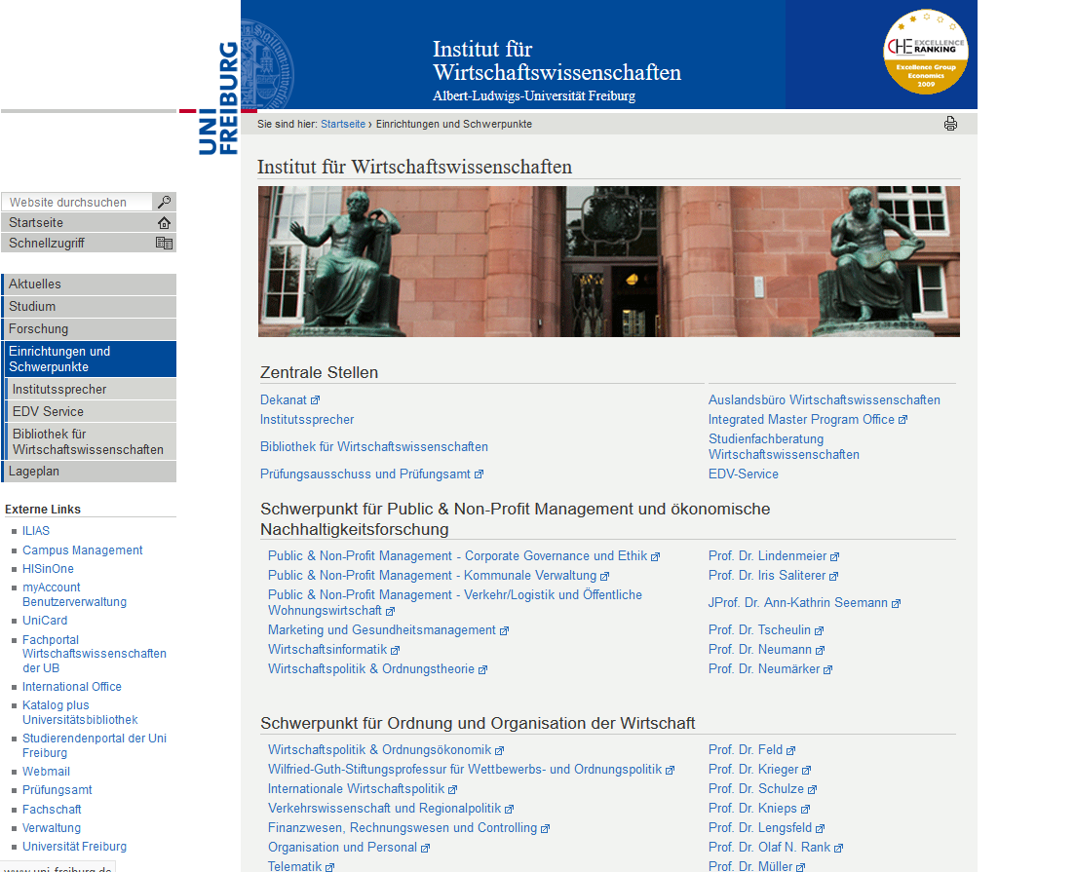

Slide 8
The Department: the Main Chairs
 | Chair | Director
1 | Constitutional Political Economy and Competition Policy | Prof. Dr. Tim Krieger
2 | Quantitative Finance | Prof. Dr. Eva Lütkebohmert-Holtz
3 | Information Systems Research | Prof. Dr. Dirk Neumann
4 | Economic Policy and Constitutional Economic Theory | Prof. Dr. Bernhard Neumärker
5 | Economic Theory | Prof. Dr. Oliver Landmann
6 | International Economic Policy | Prof. Dr. Günther G. Schulze
7 | Political Economy and Ordoliberalism | Prof. Dr. Dr. h.c. Lars P. Feld
8 | Empirical Research and Econometrics | Dr. Marc Piopiunik
9 | Network Economics, Competition Economics and Transport Science | Prof. Dr. Günter Knieps

Slide 9
Constitutional Political Economy and Competition Policy
Director: Prof. Dr. Tim Krieger
Some Research Interests: Economic, social, and education policies in open, aging economies, Global (economic) governance, Migration and international labor mobility, Civil rights, security, and efficiency
Example of Courses Offered:Global Economic Governance, Time Series Analysis, Economics Blog, The Economics of Conflict
For more information visit:
http://www.wguth.uni-freiburg.de/news_en/herzlich-willkommen-auf-der-homepage-der-wilfried-guth-stiftungsprofessur-fuer-ordnungs-und-wettbewerbspolitik?set_language=en

Slide 10
Quantitative Finance
Director:Prof. Dr. Eva Lütkebohmert-Holtz
Some Research Interests: economic risk, developing proper methods for the quantification of financial risks and the regulation of financial markets.
Example of Courses Offered: Futures and Options, Portfolio Management, Interest Rate Theory and Applications, Principles of Finance, Topics in Behavioral Finance
For more information visit:http://www.finance.uni-freiburg.de/front-page-en-en?set_language=en

Slide 11
Information Systems Research
Director: Prof. Dr. Dirk Neumann
Some Research Interests:Big Data Analytics, Smart Grids, Predictive Analytics
Example of Courses Offered: Computational Economics, Electronic Markets, Advanced Business Analytics, Optimization and Simulation
For more information visit:https://www.is.uni-freiburg.de/

Slide 12
Economic Policy and Constitutional Economic Theory
Director: Prof. Dr. Bernhard Neumärker
Some Research Interests:Ordnungspolitik, Constitutional Economics and Social Contract Theory, Political Economy of Reforms, Economics of Social Justice, Economics of Conflict and Power
Example of Courses Offered: Economic Policy and Public Choice, Economics of Social Justice, Constitutional Economics
For more information visit:http://www.wipo.uni-freiburg.de/home?set_language=en

Slide 13
Economic Theory
Director:Prof. Dr. Oliver Landmann
Some Research Interests: International Monetary Economics, Macroeconomics, Germany and the Euro Crises
Example of Courses Offered: Advanced Macroeconomics I and II, International Monetary Economics I and II
For more information visit: http://www.macro.uni-freiburg.de/news/home

Slide 14
International Economic Policy
Director: Prof. Dr. Günther G. Schulze
Some Research Interests: International Economics, International Public Finance, International Environmental Economics, Development Economics, Economics of Conflict and Terrorism
Example of Courses Offered: Case Studies in Labor Economics, The Economics of Terror, The Economics of Corruption
For more information visit: http://www.vwl-iwipol.uni-freiburg.de/iwipol//sopo.htm

Slide 15
Political Economy and Ordoliberalism
Director: Prof. Dr. Dr. h.c. Lars P. Feld
Some Research Interests: constitutional economics and ordoliberal thinking in the tradition of the Freiburg School
Example of Courses Offered: Behavioral Economics, Experimental Economics
For more information visit: https://www.eucken.de/en/

Slide 16
Empirical Research and Econometrics
Director: Dr. Marc Piopiunik
Some Research Interests: Education Economics, Migration Economics, Labor Economics.
Example of Courses Offered: Intermediate Econometrics, Statistical Learning
For more information visit:https://www.empiwifo.uni-freiburg.de/

Slide 17
Network Economics, Competition Economics and Transport Science
Director: Prof. Dr. Günter Knieps
Some Research Interests: Internet of things, Network Economics
Example of Courses Offered: Network Economics, Resource Allocation and Competition Policy
For more information visit: http://portal.uni-freiburg.de/vw

